Slide 1
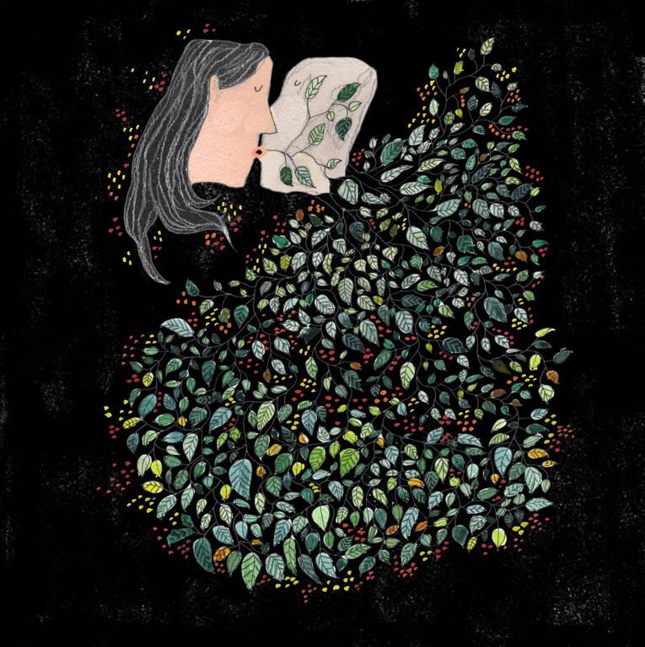
Distant Voices: Coming Home
Fergus McNeill
Professor of Criminology & Social Work
Fergus.McNeill@glasgow.ac.uk

Slide 2
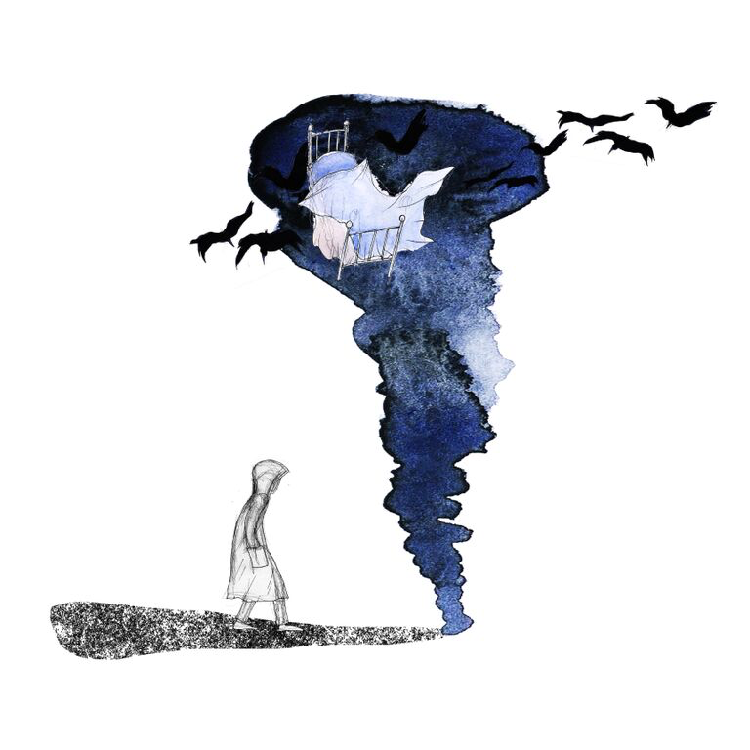

How Close is the Thunder

Slide 3
How Close is the Thunder
I always count the distance of the approaching storm
I measure it in silent seconds, while the skies are torn
My stomach churning butterflies, struggle in sideways rain
How close is the thunder? I start to count again
Will I buckle up my duffle-coat; face the storm ahead?
Or will I go upstairs; find shelter in my bed?
Difficult decisions, in this hurricane
How close is the thunder, I start to count again
Lightning illuminates nature’s awe
A message from somewhere to face it on my own
Lightning illuminate’s nature’s awe
A wake up call to face it on my own
Outside abandoned brollies drip and start to dry
Birds leaving cover, circling in the sky
Relieved to see uncertainty cleared for new terrain
How close is the thunder?

Slide 4


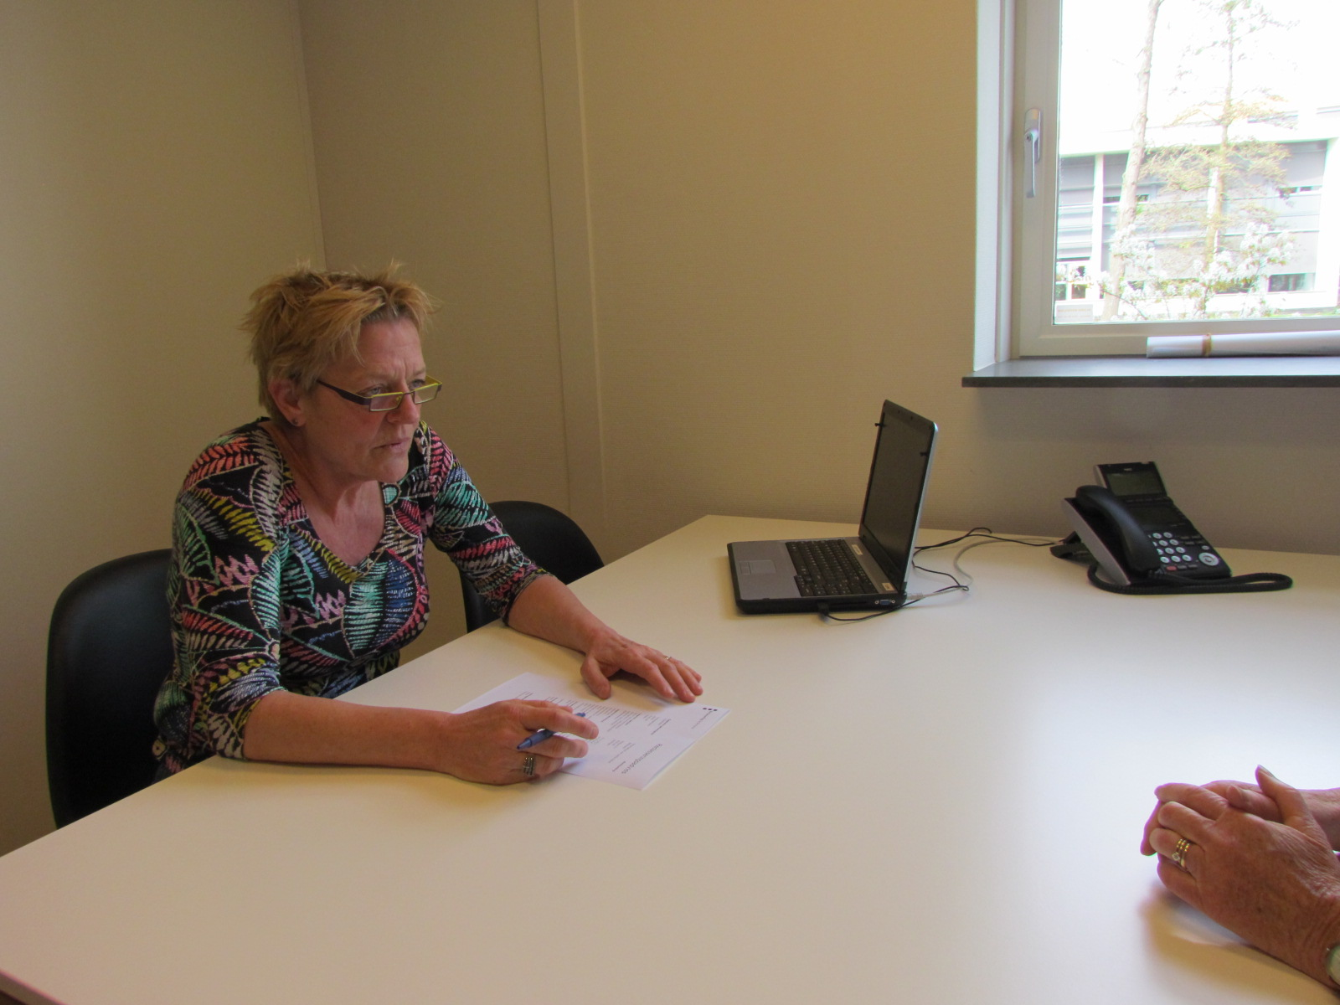
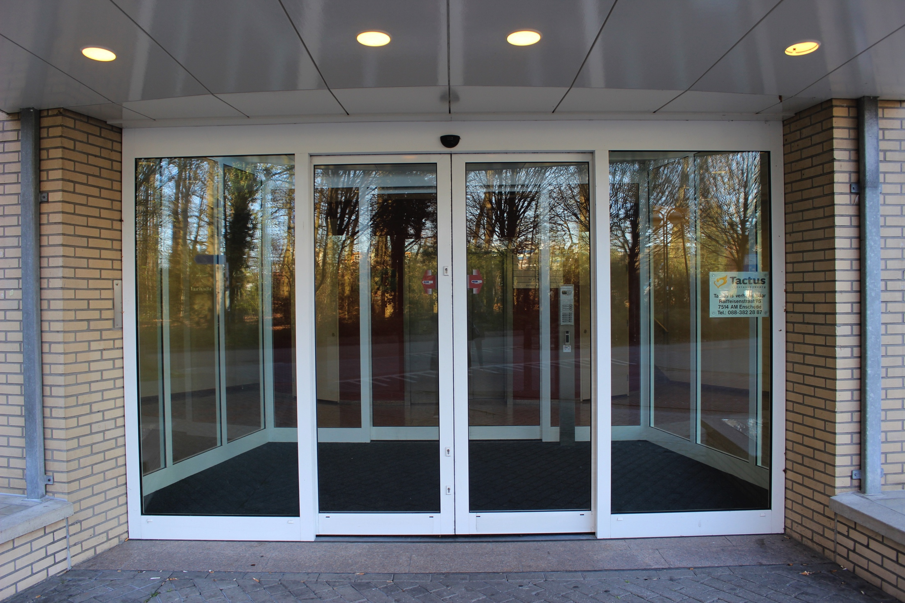
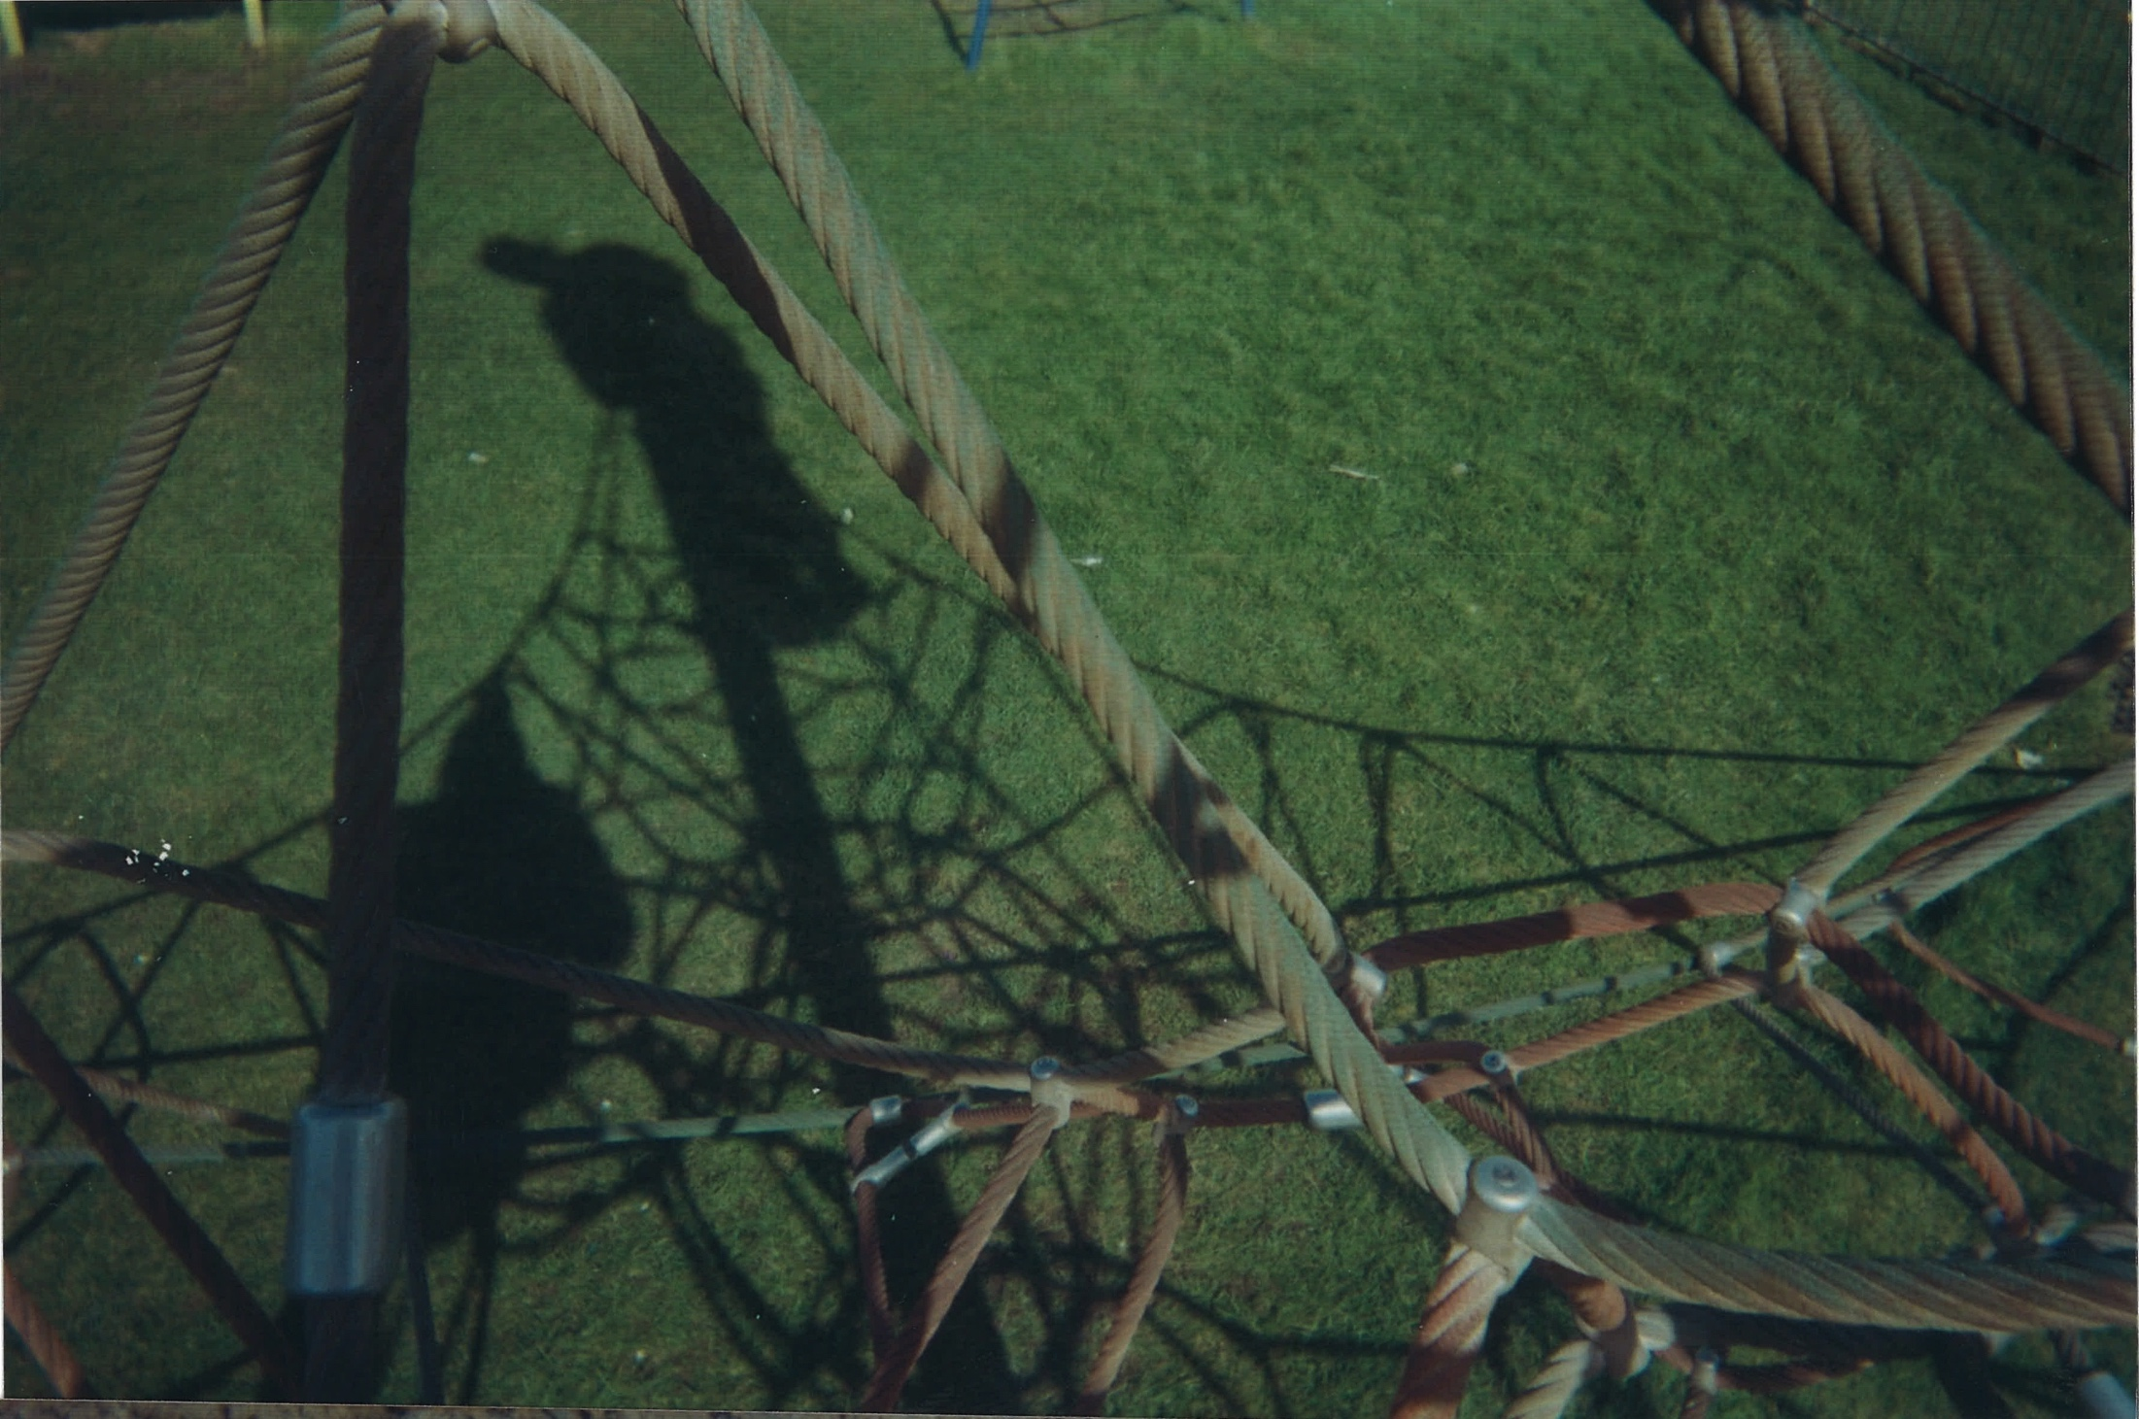
Blankface

Slide 5
Blankface
The clock spins, zero hour begins
This is the end, the end again
Here sits Blankface and she spins my tale
I’ve stopped listening now I know that I’ll fail
Tick by tick and line by line
Thread by thread now you weave mine
A web of shadows, a silk spun tomb
A windowless room, windowless room
Sliding doors open and they welcome me in
This is the place, the place we pay for sin
These four seasons they reflect in glass
Trapped in a jar here where the time will not pass
One day ending, a new day begins
Tick says ‘he’ll do it’, again and again
You see what you want but I know it’s not real
Anyone out there who can feel what I feel?

Slide 6
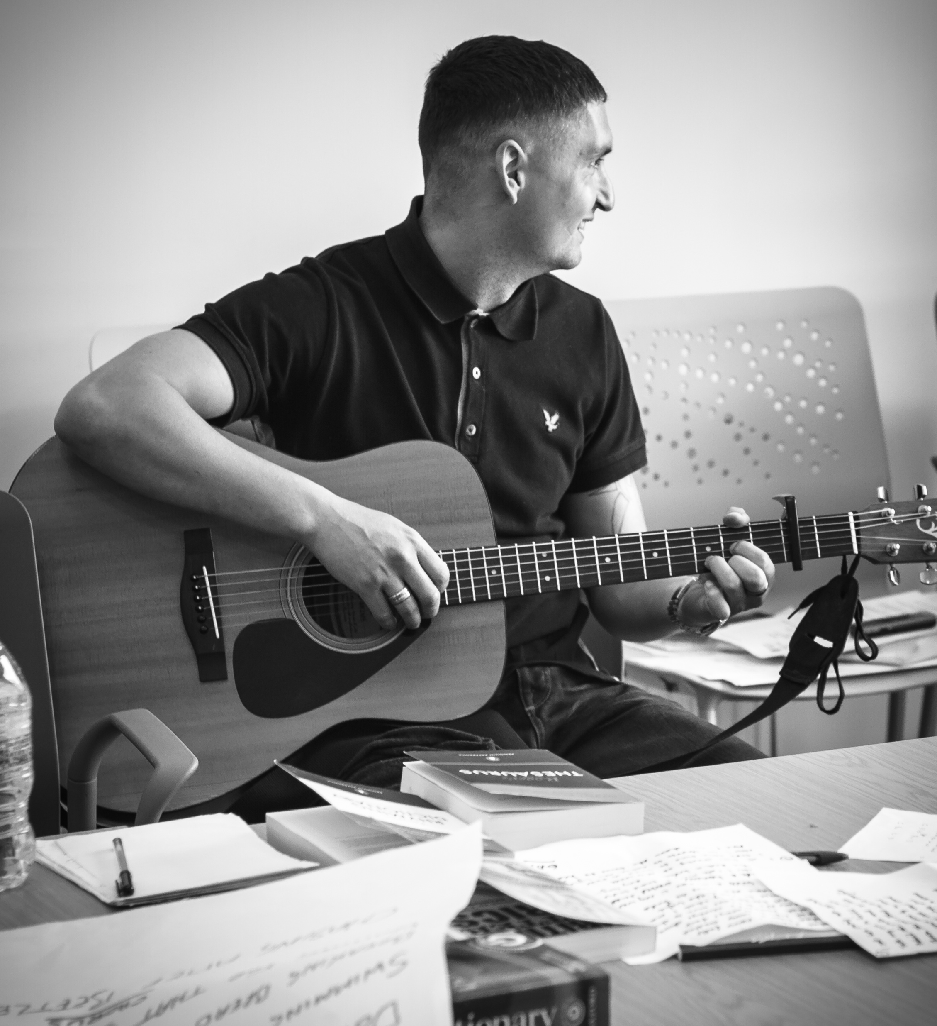
I’ve Changed

Slide 7
I’ve Changed
While the world goes on I sit
Waiting for the day to come
And it’s a long, long wait ‘til I walk out that gate
Hoping that I’ll never return, hoping that I’ll never return
I take the first steps back to life
Everything stands in my way
Here I am outcast, people cant forget my past
They’re all stuck in their ways, they’re all stuck in their ways
But no matter what, you got to pick things up
I’ve changed but they won’t let me
Oh, I’ve changed
Stay on the path of choices
I won’t get led astray
Cos there is so much more than that revolving door
The statistic gives themself away, the statistic gives themself away
But no matter what, I’m gonna pick things up
I’ve changed but they won’t let me
Oh, I’ve changed

Slide 8
Desistance
Primary (Act)
Secondary
(Identity)
Tertiary
(Relational)
Behaviour
Identity
Belonging

Slide 9
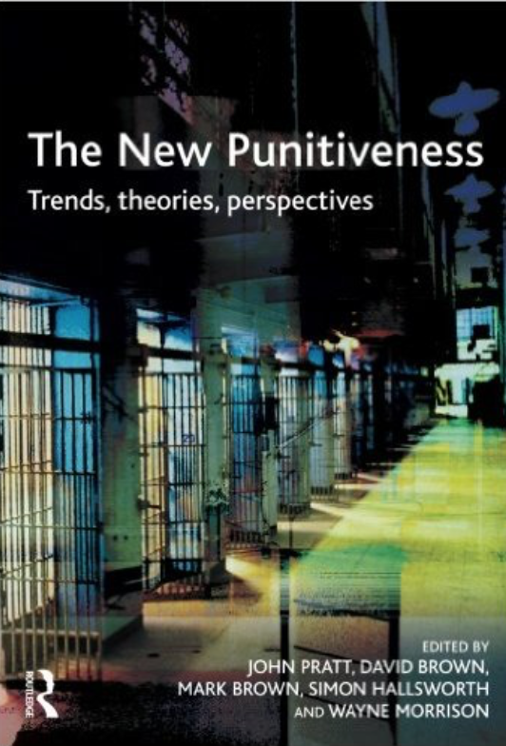


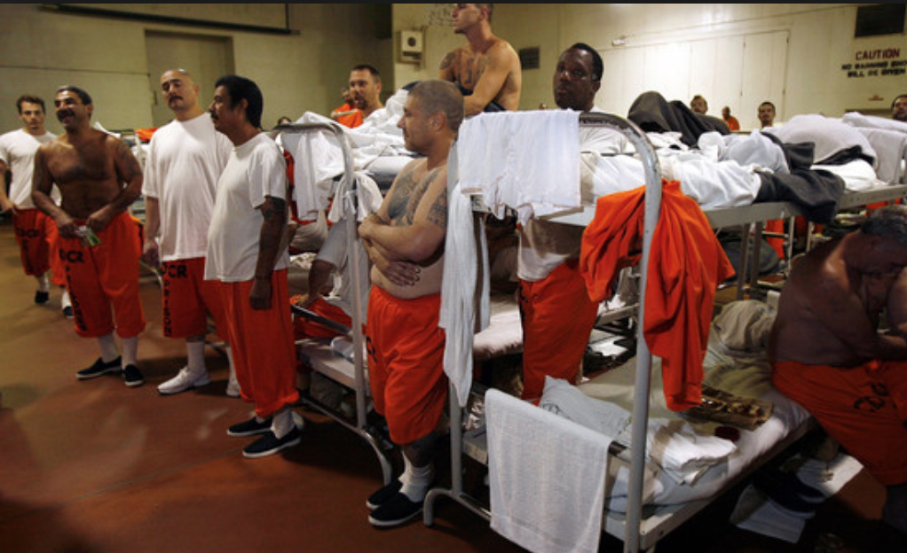
Support and sabotage
Notes:
Public attitudes
Political economy
Welfare reform
Penal policy
Effects of austerity
Enforcement and incapacitation-based approaches
Penal practice
The preoccupation with risk

Slide 10
Four forms of reintegration
Desistance
Personal
reintegration
Social
reintegration
Judicial
reintegration
Moral
reintegration
http://blogs.iriss.org.uk/discoveringdesistance/useful-resources/http//blogs.iriss.org.uk/discoveringdesistance/files/2011/09/McNeill-2012-Four-forms-of-offender-rehabilitation.pdf
Notes:
Why creative practices? Why music?
Tackling the emotive and visceral aspects of our responses to crime (Maruna and King, 2008)
This requires a deeper and more affective, collective engagement with these issues
Collective (across different experiences and interests)
Creative (through making music, participants explore and make connections)
Affective communication (Songs are then shared in public and professional forums and through print and broadcast media, inviting more people to engage seriously with questions around and practices of re/integration)

Slide 11
Why music?
Tackling the emotive and visceral aspects of our responses to crime (Maruna and King, 2008)
This requires a deeper and more affective, collective engagement with these issues
  Collective (across different experiences and interests)
  Creative (through making music, participants explore and make connections)
  Affective communication (Songs are then shared in public and professional forums and through print and broadcast media, inviting more people to engage seriously with questions around and practices of re/integration)

Slide 12
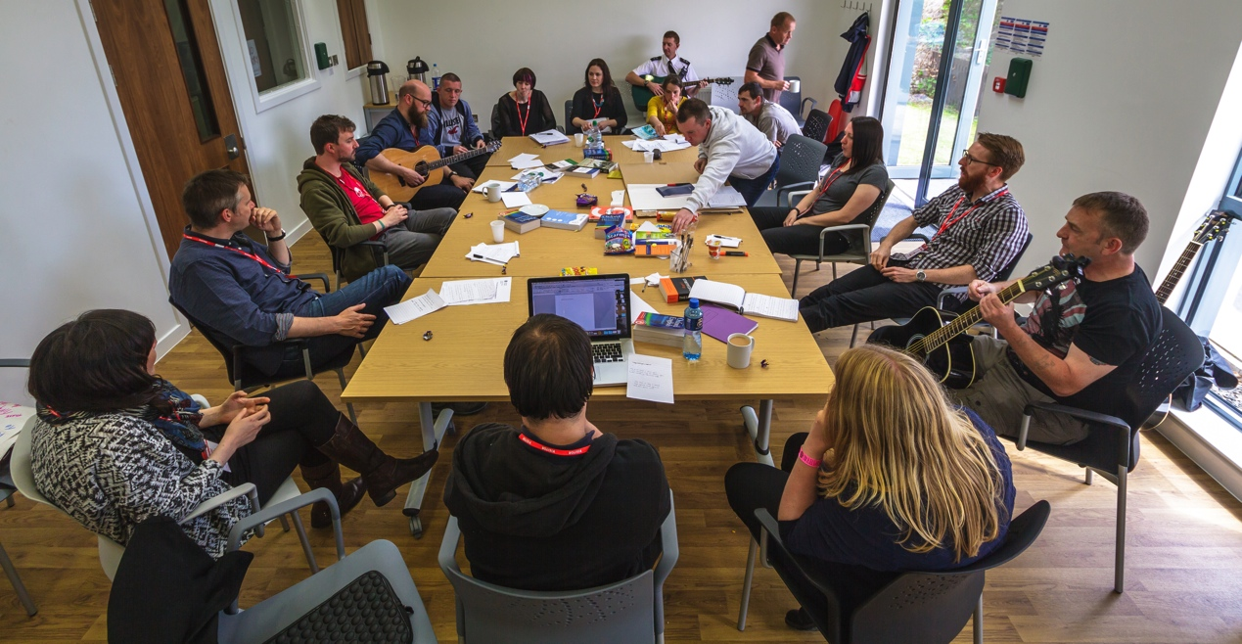
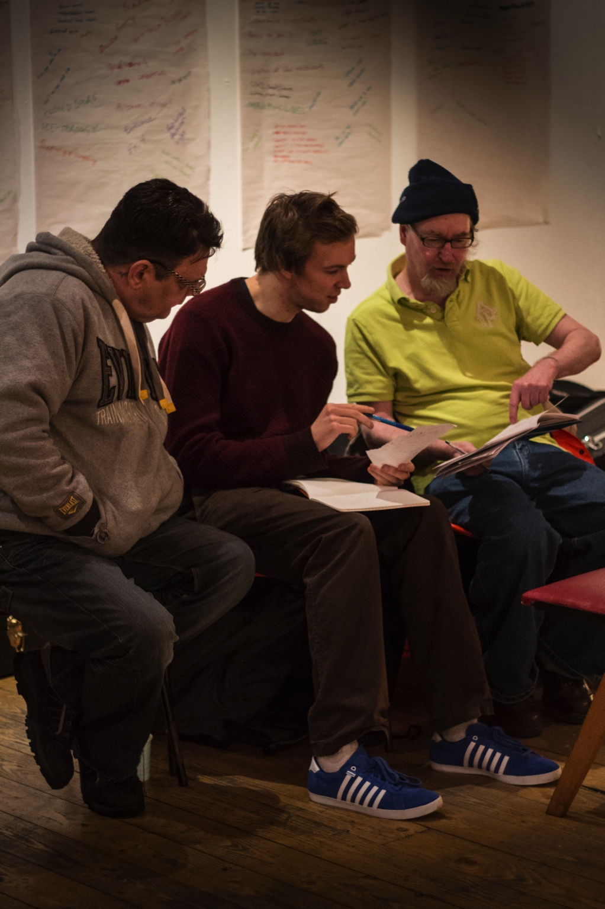
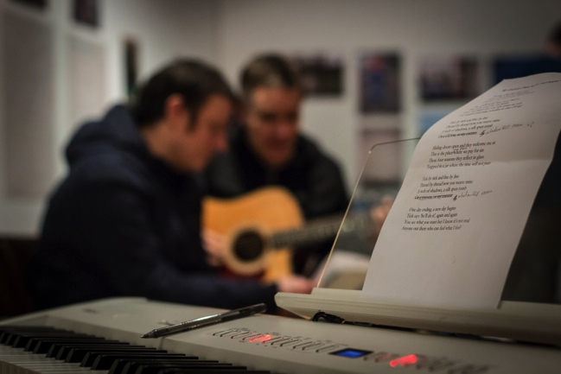
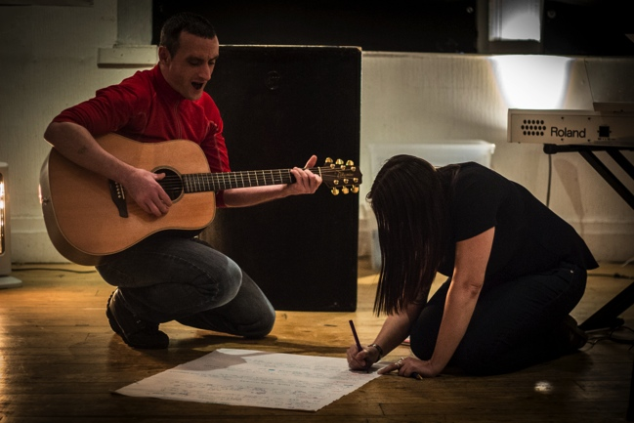

Slide 13
Music (making)
Development of communication and awareness skills, ability to think and act creatively (Rimmer, Higham and Brown, 2014)
Self-confidence, the building of positive links between individuals and wider communities (DCMS, 1999; Jermyn, 2001)
Improved social cohesion, community empowerment, self-determination and social inclusion (Jermyn, 2004)

Slide 14
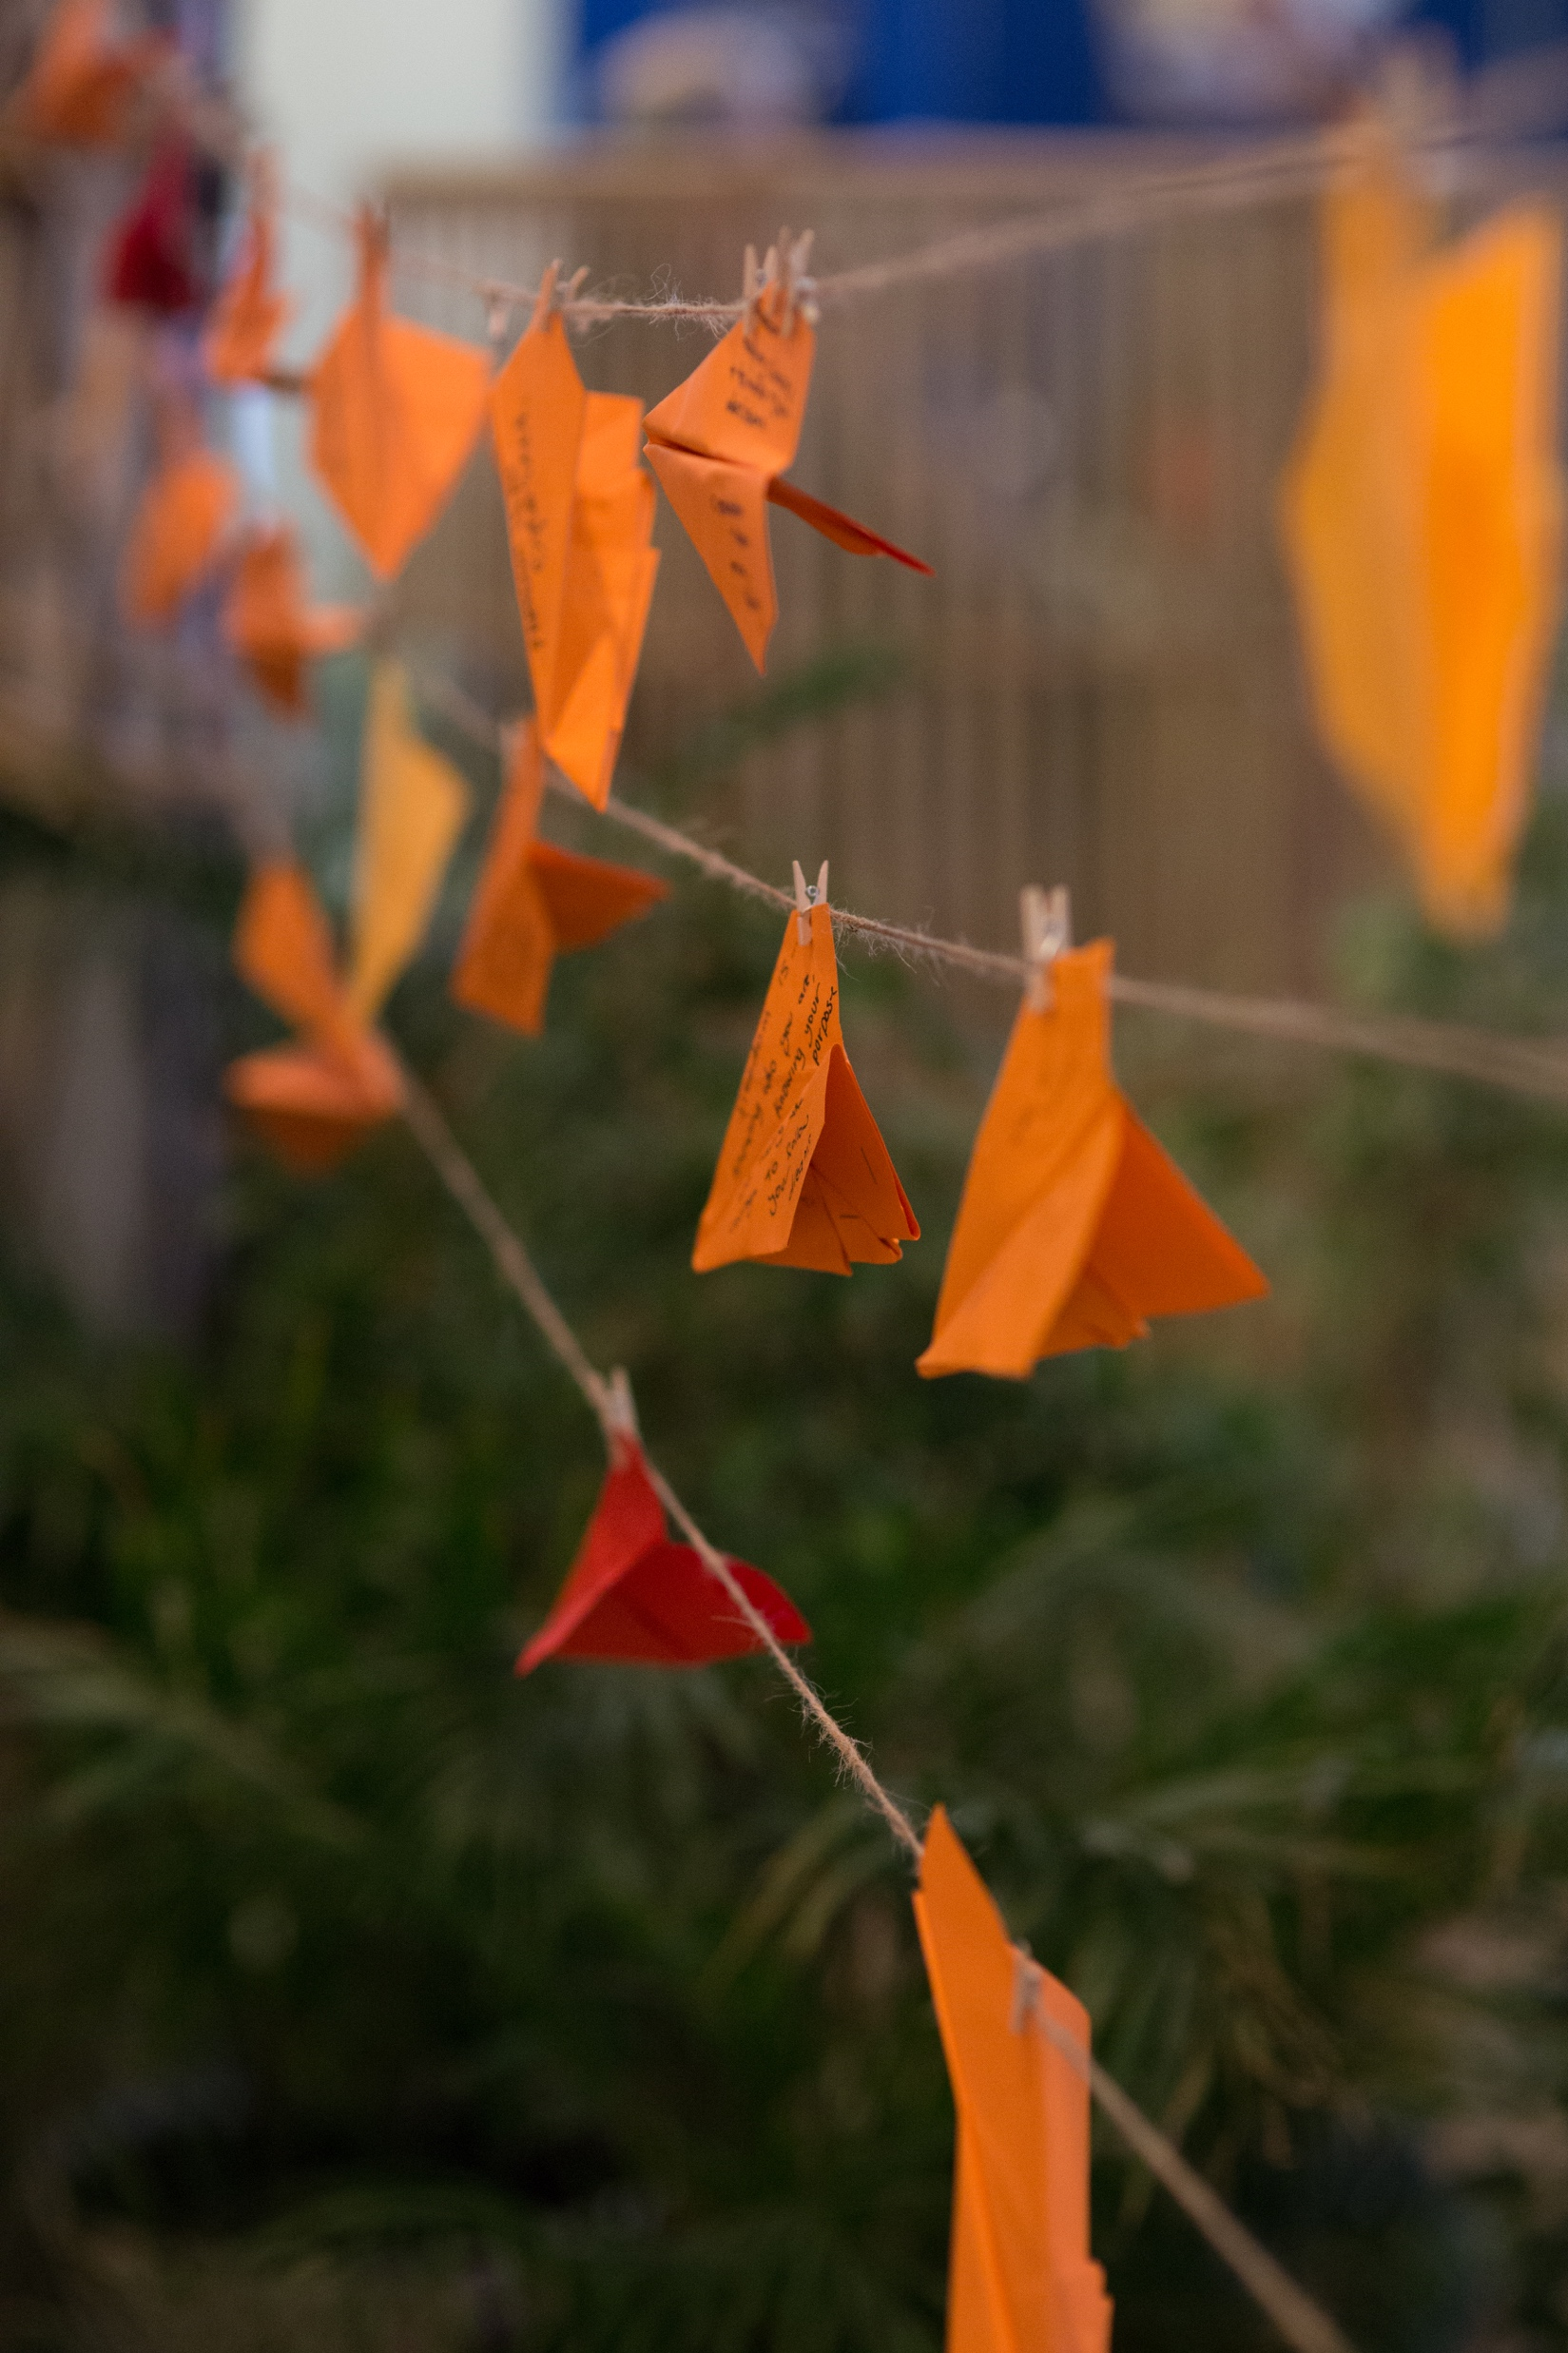
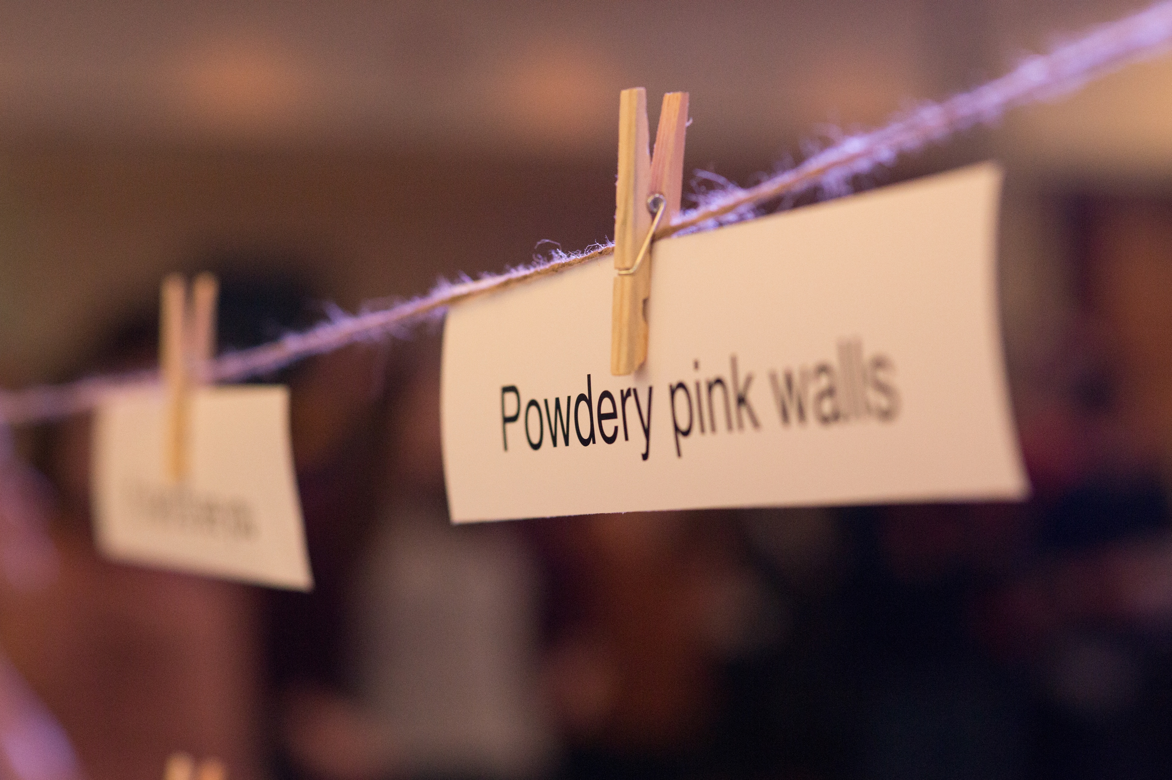
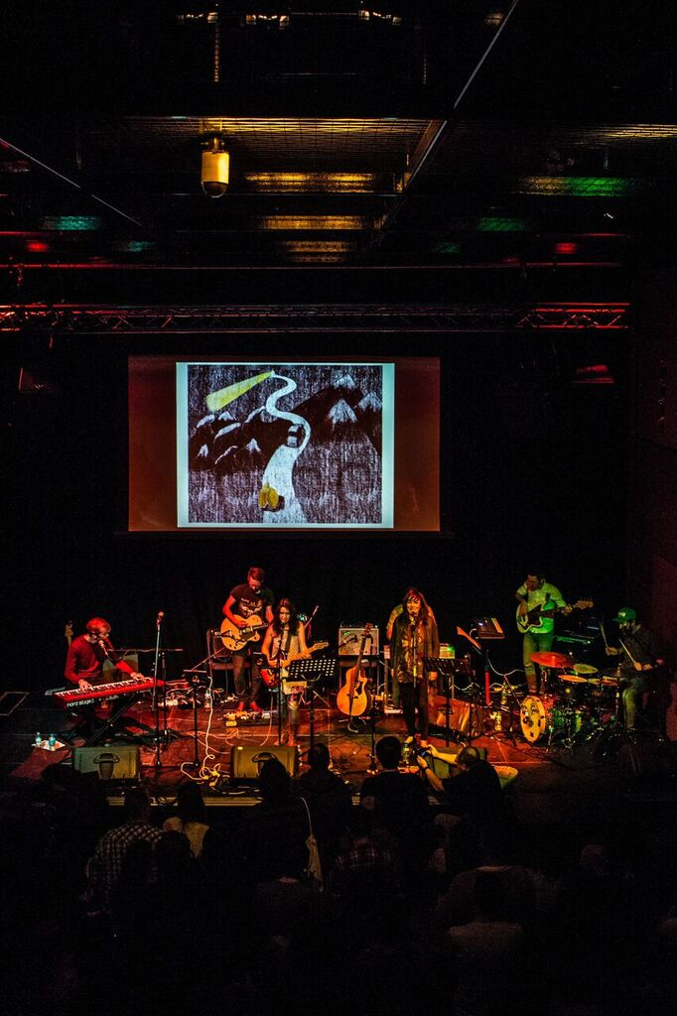
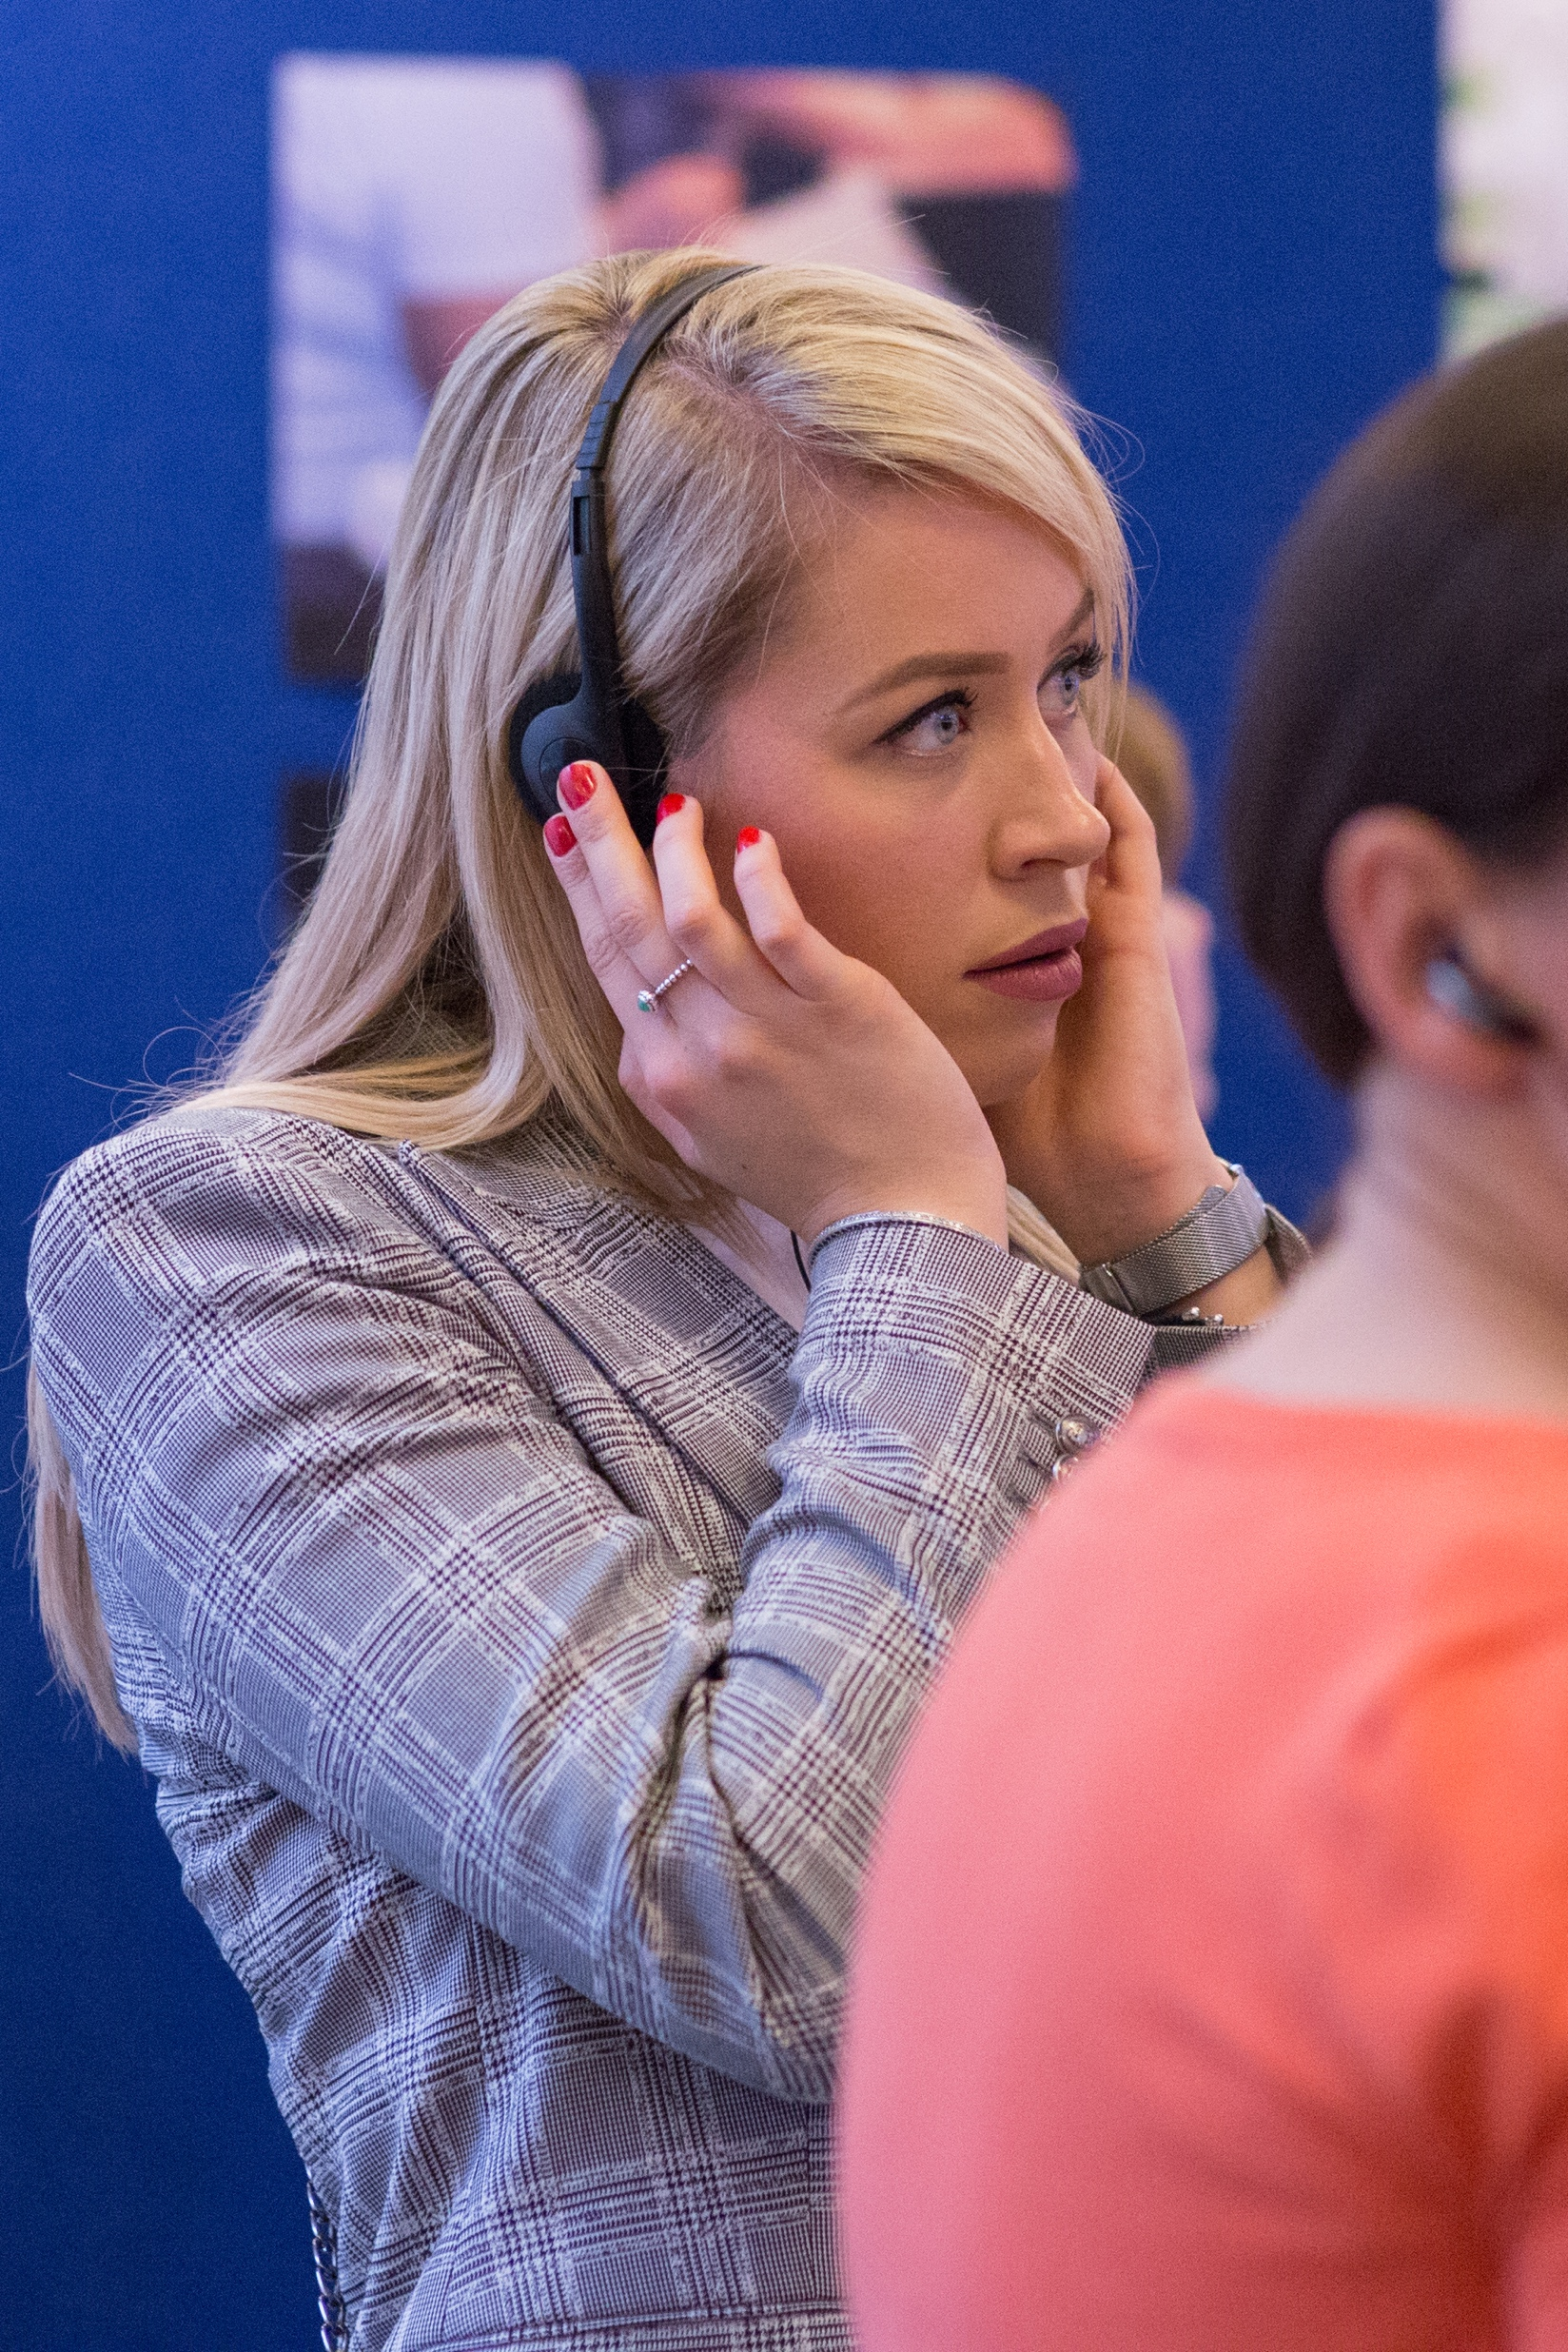


Slide 15
Music (sharing)
Benefits for audiences
  Popular music can influence affective aspects of political process and function as a social force (connecting the political aspirations and activities of audiences) creating ‘free spaces’ in public settings; spaces of opportunity for resistance to social conditioning and for mediation between socially accepted and socially proscribed values (e.g. Pratt, 1994; Lipsitz, 1994).
  “Storytelling reveals meaning without committing the error of defining it” (Hannah Arendt)

Slide 16
How?
The mechanisms producing these effects are not well understood but may be influenced by
  The primarily informal nature of the learning (Green, 2002); social and collaborative nature (Small, 1998; Anderson, 2013);
  Creation of ‘enclaves of autonomy’ within larger institutions or power structures (Pratt, 1994; Dougan, 1999);
  It offers a means of expression that overcomes ‘hermeneutical injustice’ (failures of understanding and misrecognition)(Fricker, 2007).

Slide 17
Politics?
Counterproductive aspects of debate as the default form of political communication (Tannen 1999; Baxter & Cissna 2004).
  Oversimplification, stereotyping, polarisation, confrontation and ultimately disaffection from political life and subsequent loss of social capital (Escobar 2011; Mutz 2006).
  Can make public spaces inaccessible and unappealing to citizens less accustomed to or adept at certain forms of public speaking, advantaging the most privileged sections of society (Young 2001).
Cf. Dialogic approaches
  Foster a range of individual, community and democratic goods, particularly in hotly contested and divisive topics (Littlejohn & Domenici 2001; Forester 2009).

Slide 18
Questions and ‘Clews’
How do individual citizens and civil society institutions experience, make sense of and engage in re/integration after punishment -- whether as citizens ‘coming home’ or as those receiving them?
How and with what effects does making and sharing art (principally songs) (a) represent and (b) support re/integration? How can we best understand the social, political, ethical and aesthetic nature and potential of these encounters and what they reveal about re/integration?

Slide 19
Questions and ‘Clews’
To what extent and in what ways can culturally mediated public dialogue about re/integration enable the development of social relations and social capital, supporting citizen and civil society engagement in re/integration?
To what extent and in what ways does participation in co-creative enquiry and public dialogue stimulate wider individual and community participation in other aspects of social and political life beyond the question of reintegration (e.g. policy processes, elections, community action)?

Slide 20
Participatory Workshops
Participant Observation
Practice-led research
Community of Enquiry
Core group
Research team
DV
Making
DV
Sharing
DV
Understanding

Slide 21
‘Distant Voices – Coming Home’
A Collaborative Action Research Model,
led by a research team supporting a core group,
representative of a wider community of enquiry
A. Co-Creative Inquiry
B. Co-Creative Dialogue
C. Co-Creative Discovery
Collaborative participant observation
Participatory research workshops (and ancillary methods)
Practice-led research
Producing an album of 10 songs
Tour and other participatory public events
Podcasts and web-based dialogue
Broadcast media
Songwriting sessions in prisons and community justice sites (and with others)
Vox Unbound

Slide 22
Reflexivity
New ways of knowing, seeing, hearing
  Challenge familiar ‘findings’
  Challenge familiar roles and power dynamics
New levels (and terms) of affective engagement… with consequences
  Risking more of oneself…
  Vulnerability and mutuality in processes of shared discovery
  Blurring the personal, professional, political
  Studying and doing reintegration
  Without forgetting the peculiar nature of our own contributions… and providing ‘authentic accounts of embeddedness…’ (Sabrina Keinemans)

Slide 23

Frank’s Song

Slide 24
Frank’s Song
Long hours, sore fingers, the melody lingers
First tune, beaming smile, feel the style
Calloused hands, stiff wrist, getting the gist
First riff, eyes wide, glowing pride
Long hours, no money, like running through honey
First gig, showtime, sunshine

Slide 25

Never Got to Say Goodbye

Slide 26
Never Got to Say Goodbye
Tumbling in the car, down the quiet country roads
Slowing for the bends and zooming on the straight and narrows
Daylight fades to black, turning up the radio
Don’t want to look back, never caring where we go
You’ve become the longest gaze out the window
At the blinking star in the sky
The comfort in the clouds and silver linings, floating by
Never got to say goodbye
Driving way too close to the cars in front of you
Doesn’t bother me; I’m safer when you’ve had a few
Window rolled down smoke curls off your cigarette
Trees all running past soldiers in a silhouette
Mum’s lost without you, Barry he’s lost too
Natalie’s heart broken, Nicky is blue
Never got to say goodbye

Slide 27
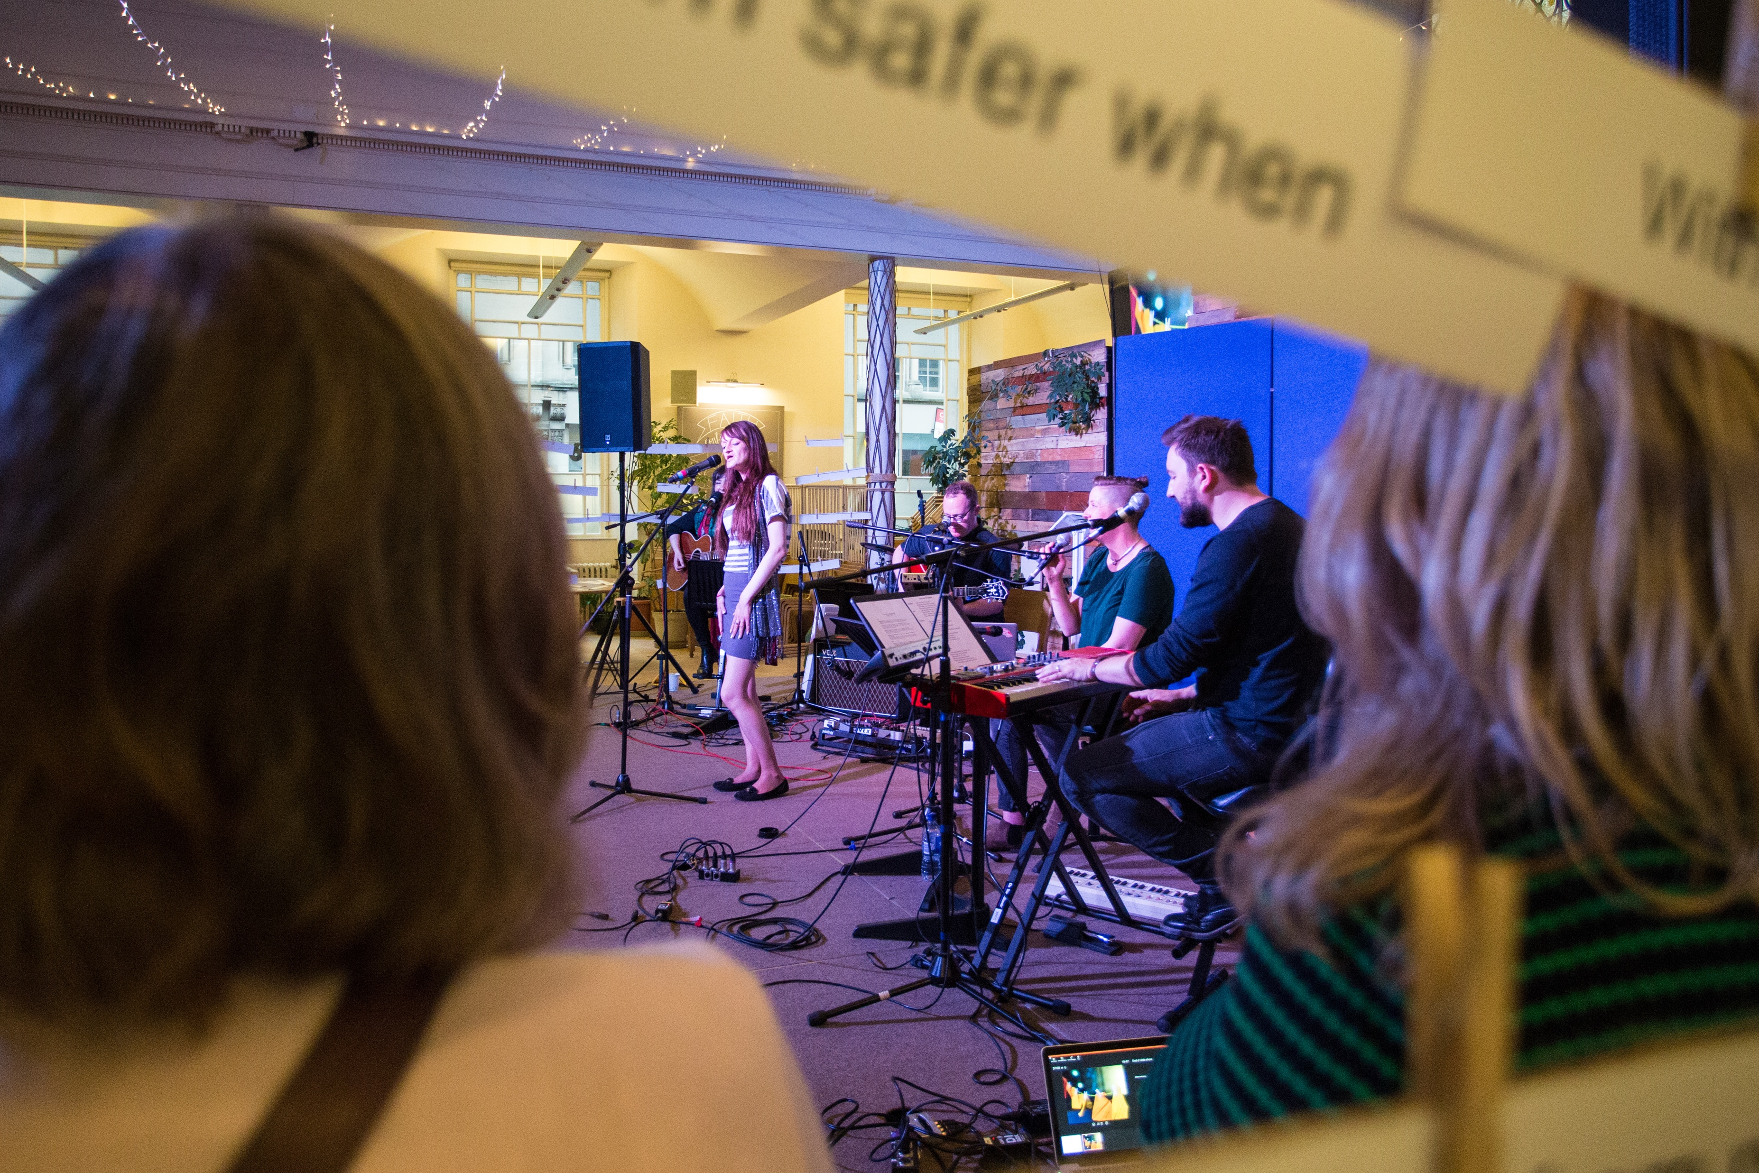
Freedom is on the Way

Slide 28
Freedom is on the Way
Jeremy Kyle with the curtains closed
No-one to turn to, nowhere to go
Feeling imprisoned, bird in a cage
Faces in frames reminding me, no
Fear of being judged: I hide away
I want to change but change is scary
Scary for anyone, never mind me
Fighting for scraps of dignity
Walking down that one way street -- I know where it leads
But I still walk -- searching for freedom
Freedom must be on the way
I’ve come a long way, since the dark
Now I feel some contentment
Just want to be normal; whatever that is
I feel independent
Freedom is riding through the fields, open wilderness, wind in the hair
Freedom is dancing, letting it all go -- jumping about like I just don’t care

Slide 29
Theoria (theorising)
Praxis (practicing)
Re/integration
Poiesis (making)

