Slide 1
EXPERTS BY EXPERIENCE? prisoners as researchers - Ethical and practical problems
Professor Nick Hardwick
Royal Holloway University of London
Mapping the transformative potential of participatory styles of research with vulnerable, marginalised and/or hard-to-reach groups
Independent Social Research Foundation (ISRF) Research Residential
Girton College, Cambridge, 20-25th August 2017

Slide 2
Prison population and staff
Prison population: 86,368
Operational capacity: 87,201 (99.04%)
Number of prisons overcrowded: 80/69%
Reduction in staff Mar ‘10 to Jun ‘17: 9,753/22%

Slide 4
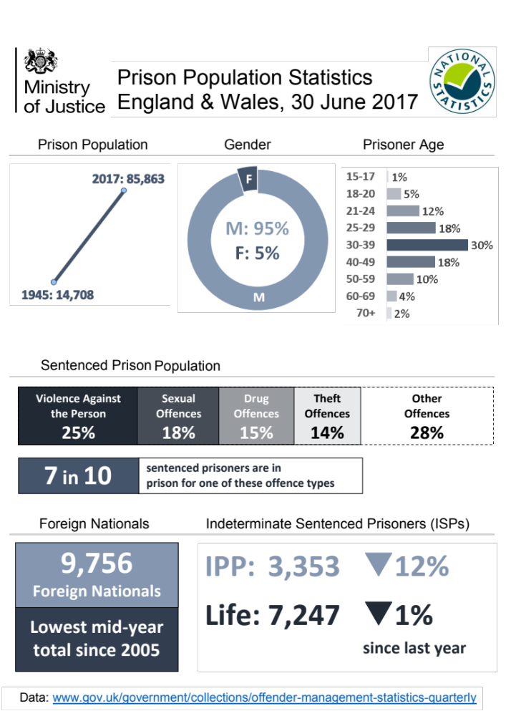

Slide 5
Most recent twelve month prison safety data compared with June 2007
316 deaths in prison custody, up 78%
97 apparent self-inflicted deaths, up 23%
2 homicides, no increase
40,414 reported incidents of self-harm, up 74%
11,010 prisoners self-harmed, up 57%
26,643 assaults, up 68%
3,606 serious assaults, up 145%
7,159 assaults on staff, up 133%
805 serious assaults on staff, up 212%

Slide 6
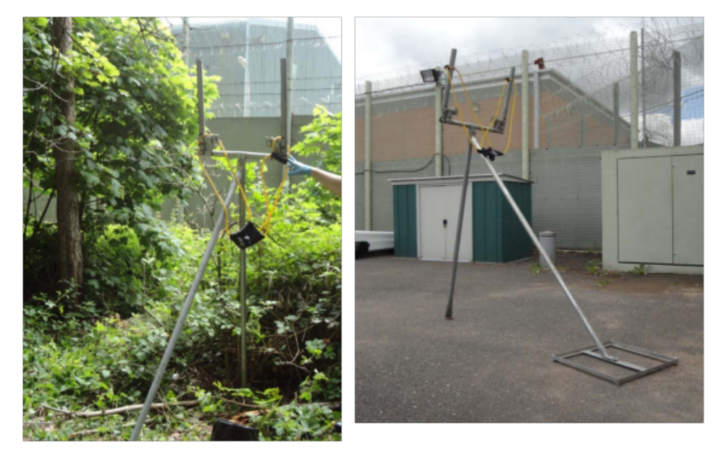
Notes:
Legal highs. Catapults for delivery

Slide 7
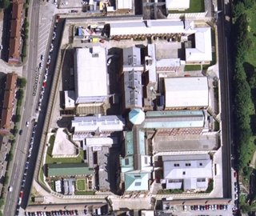
Notes:
HMP Hull – Typical city centre Victorian Prison. Opened 1870. Panopticon design with modern buildings infilled between wings

Slide 8


Slide 9
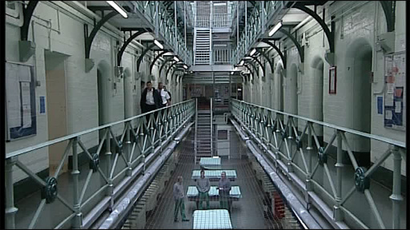

Slide 10
How long to you spend out of your cell on a week day?
 | Spend more than 10 hours out of cell (weekday) (%) | Spend less than two hours out of cell (weekday) (%)
Local prisons | 8 | 31
Cat B training prisons | 15 | 16
Cat C training prisons | 13 | 11
Young adult prisons | 4 | 37
Open prisons | 54 | 2
Average | 14 | 22
HMI Prisons Annual Report 2016/17
Notes:
Recycling workshop

Slide 12
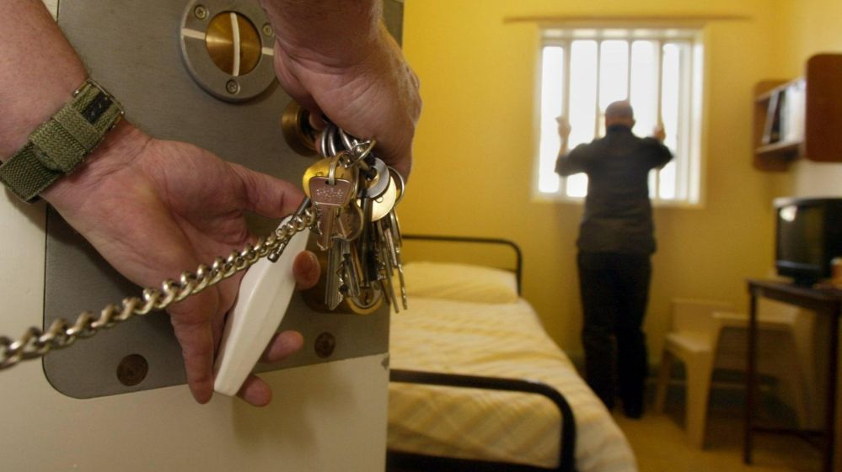

Slide 13
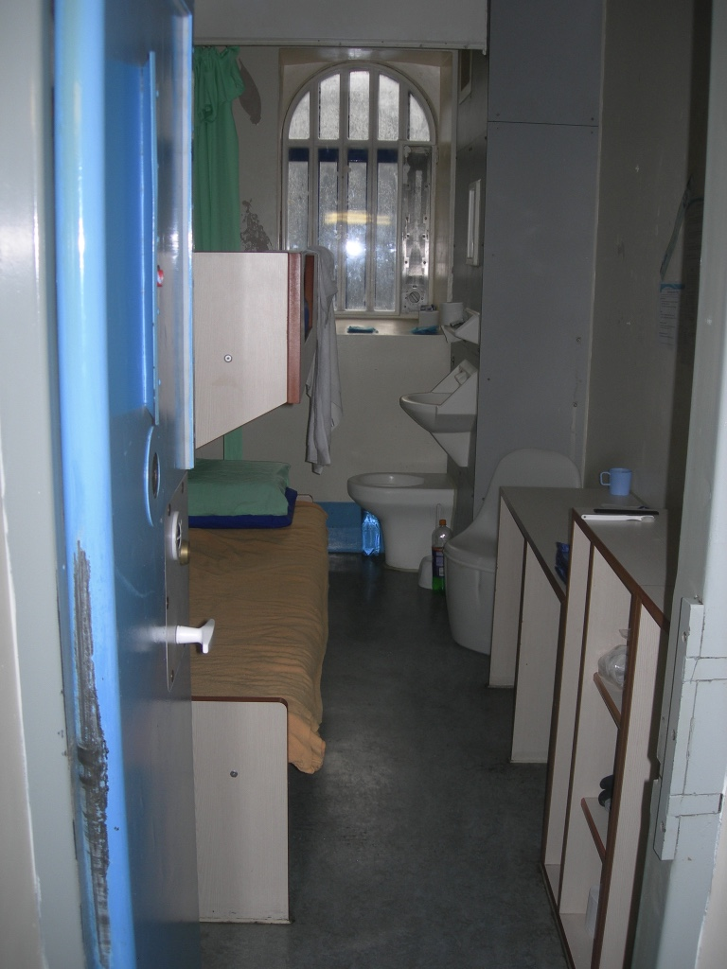
Notes:
HMP Hull – two person cell

Slide 14
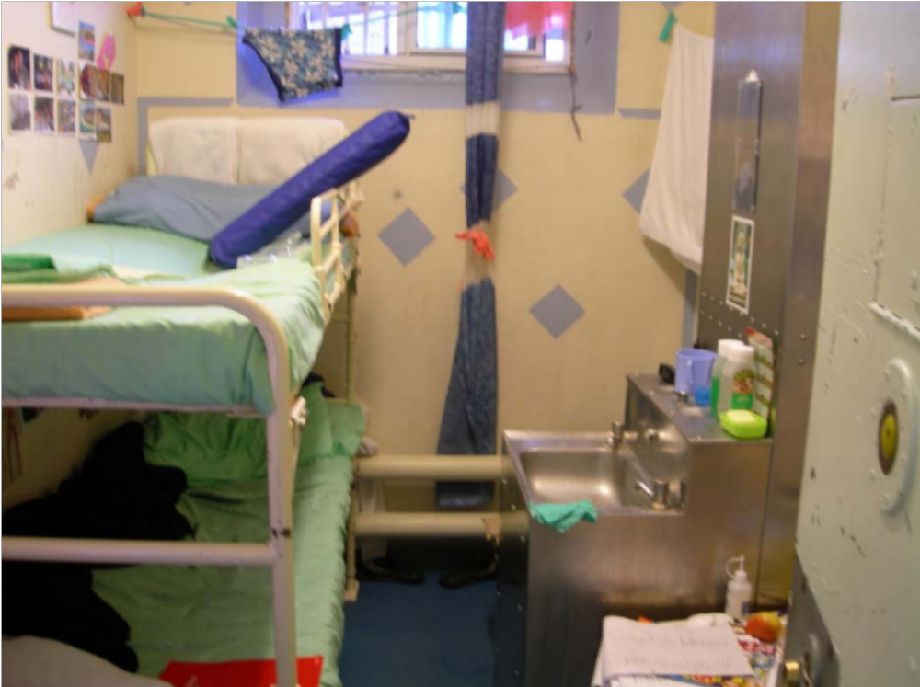

Slide 15
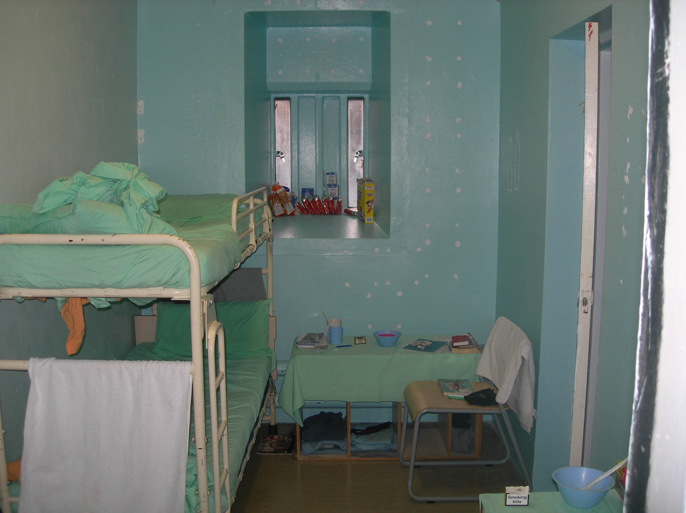

Slide 16
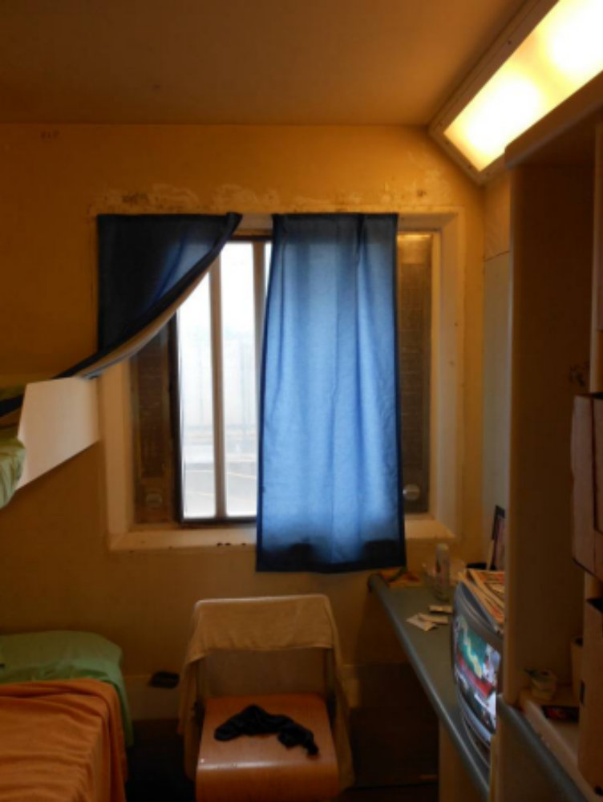

Slide 17
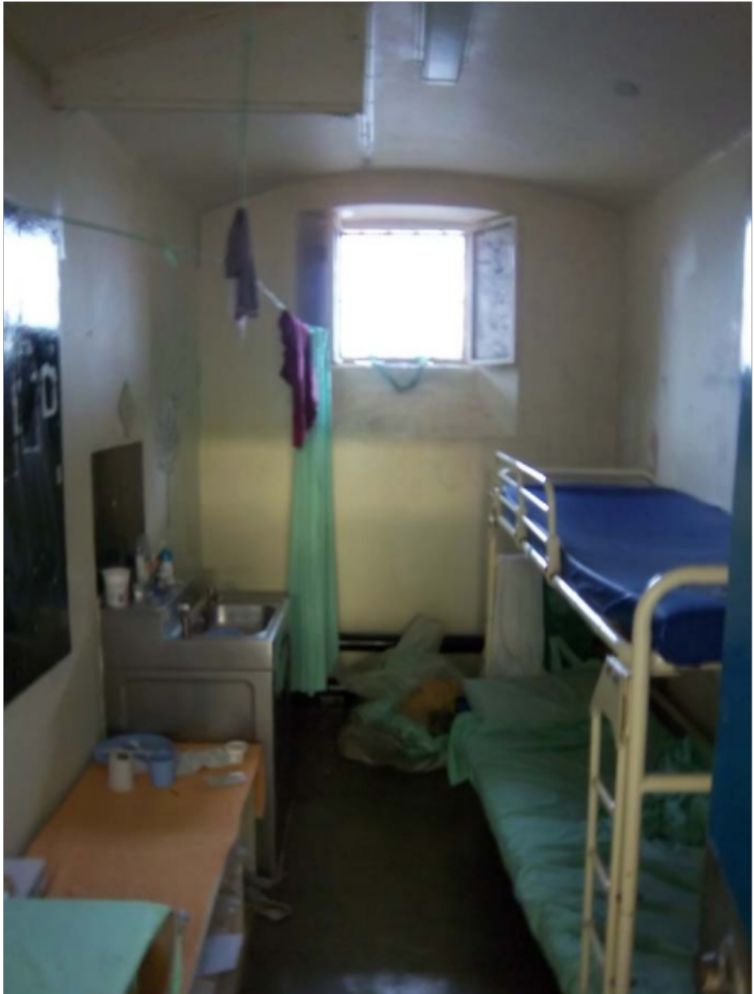

Slide 18
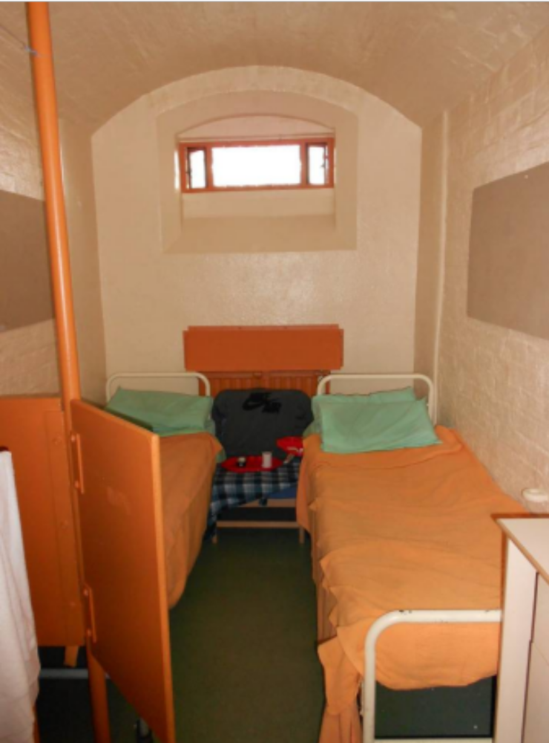

Slide 19
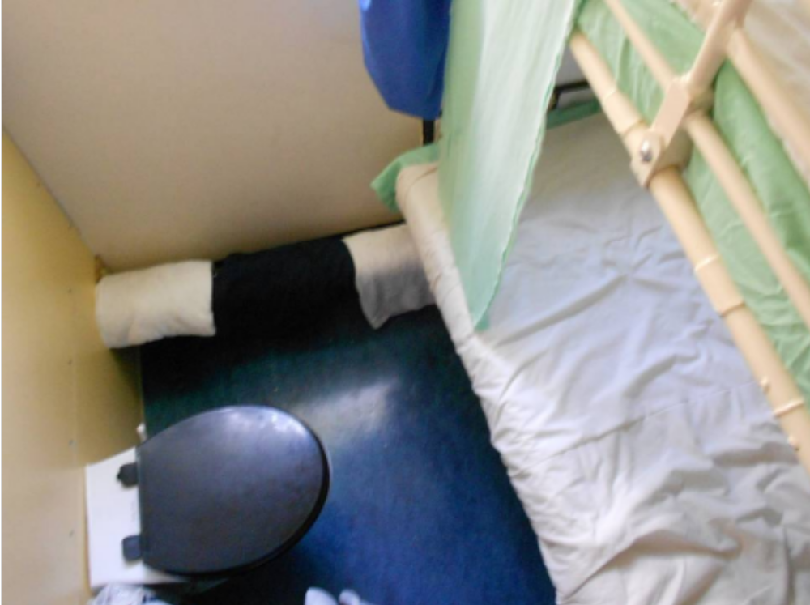

Slide 20
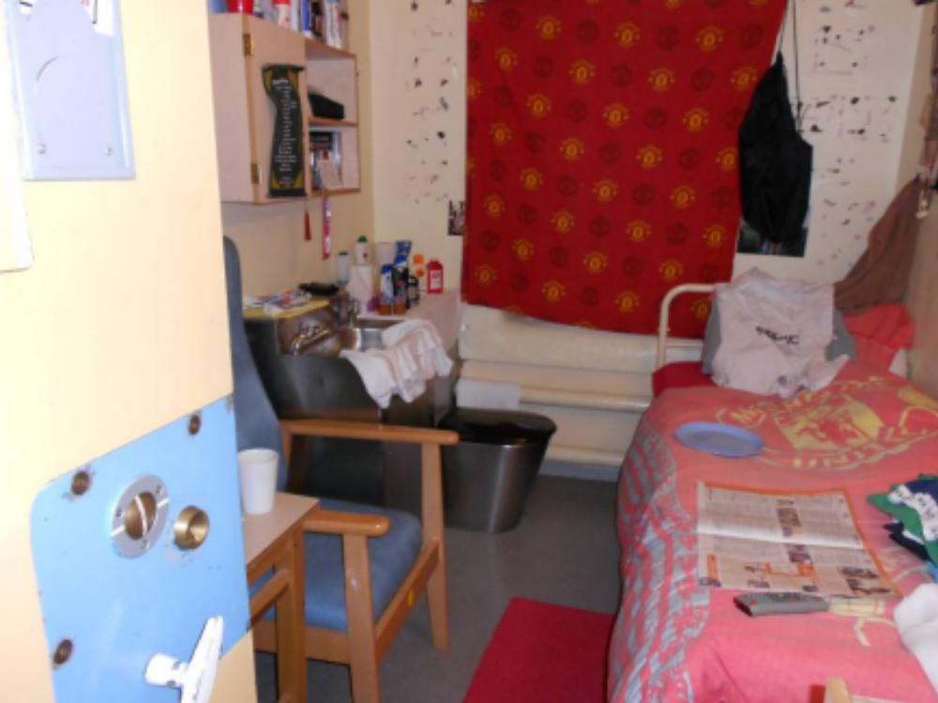
Notes:
Colour

Slide 21
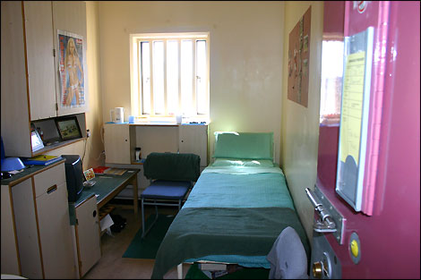
Notes:
HMP Nottingham – Rebuilt 2010. Single cell.

Slide 22
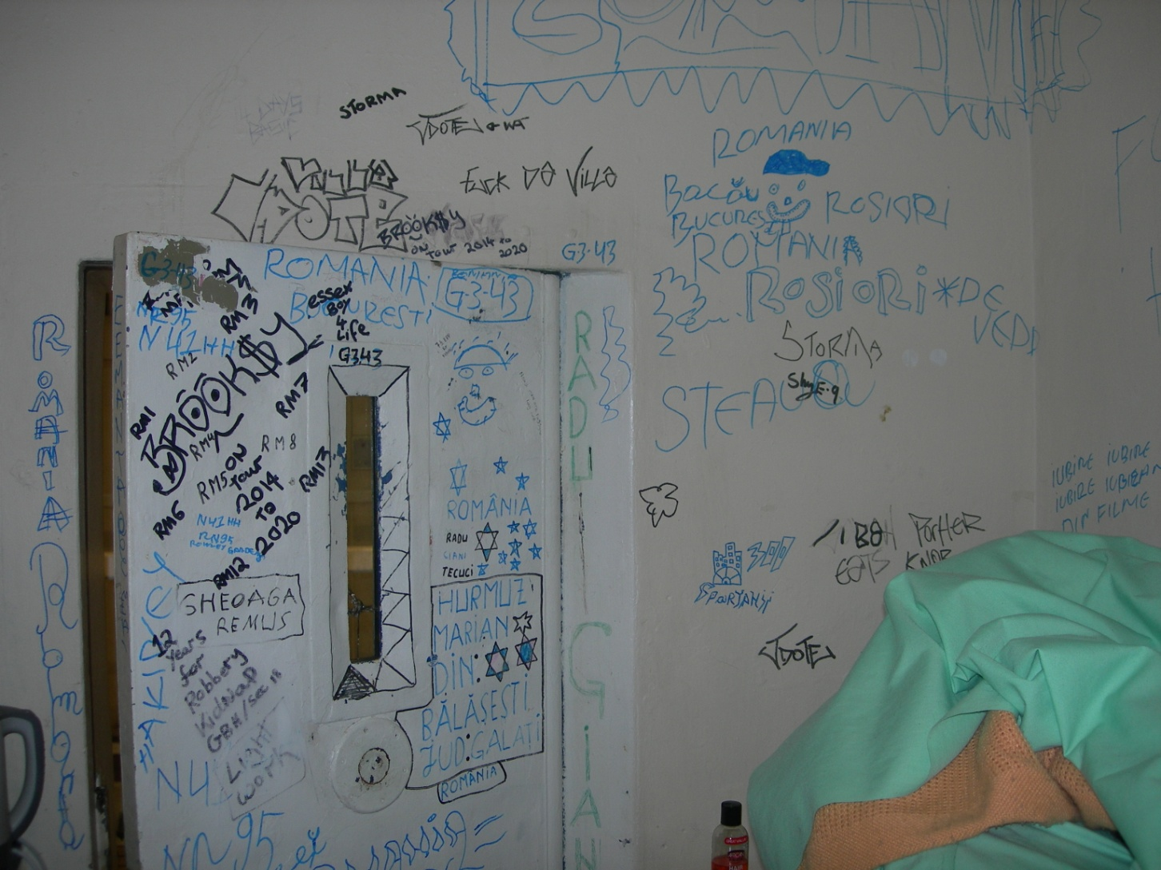
Notes:
HMP Pentonville – Occupied cell

Slide 23
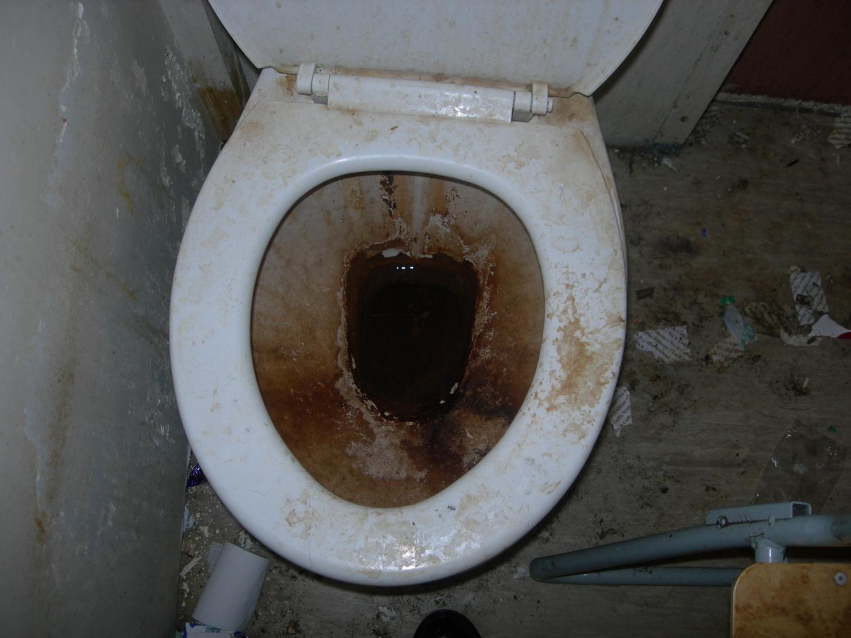
Notes:
HMP Pentonville – Occupied cell

Slide 24
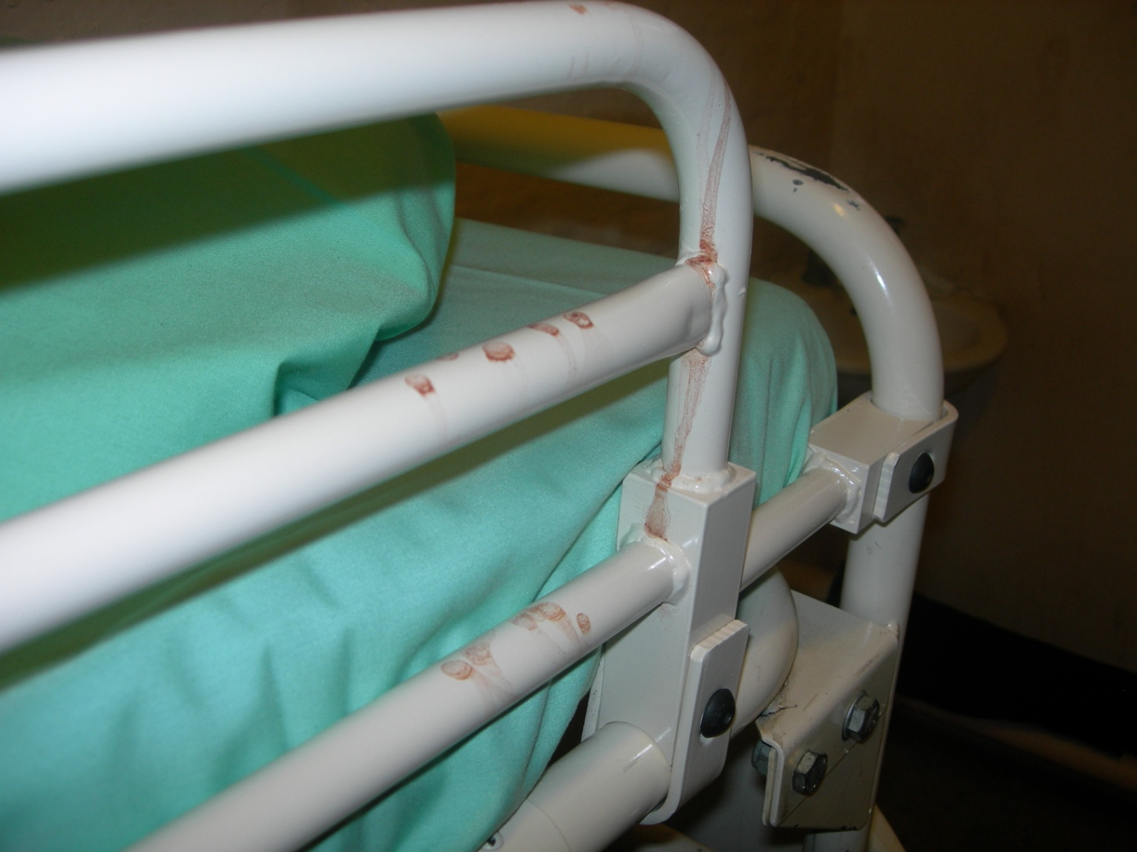
Notes:
HMP Pentonville – First night cell ready for use

Slide 25
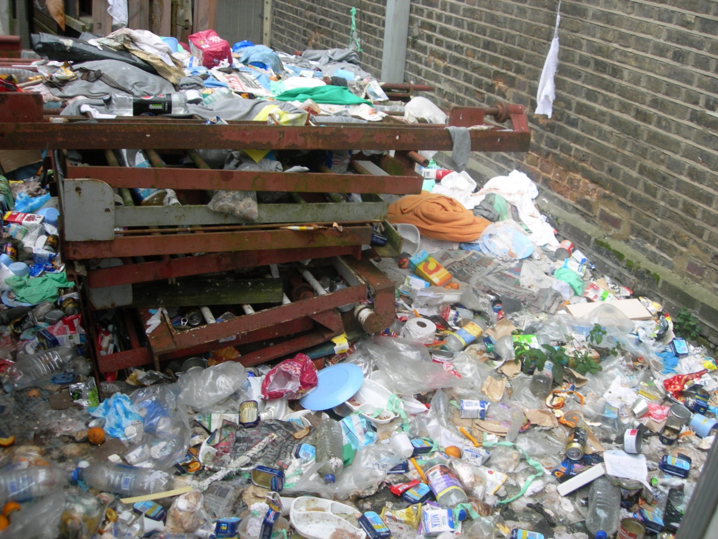
Notes:
HMP Pentonville - - Outside a win

Slide 26
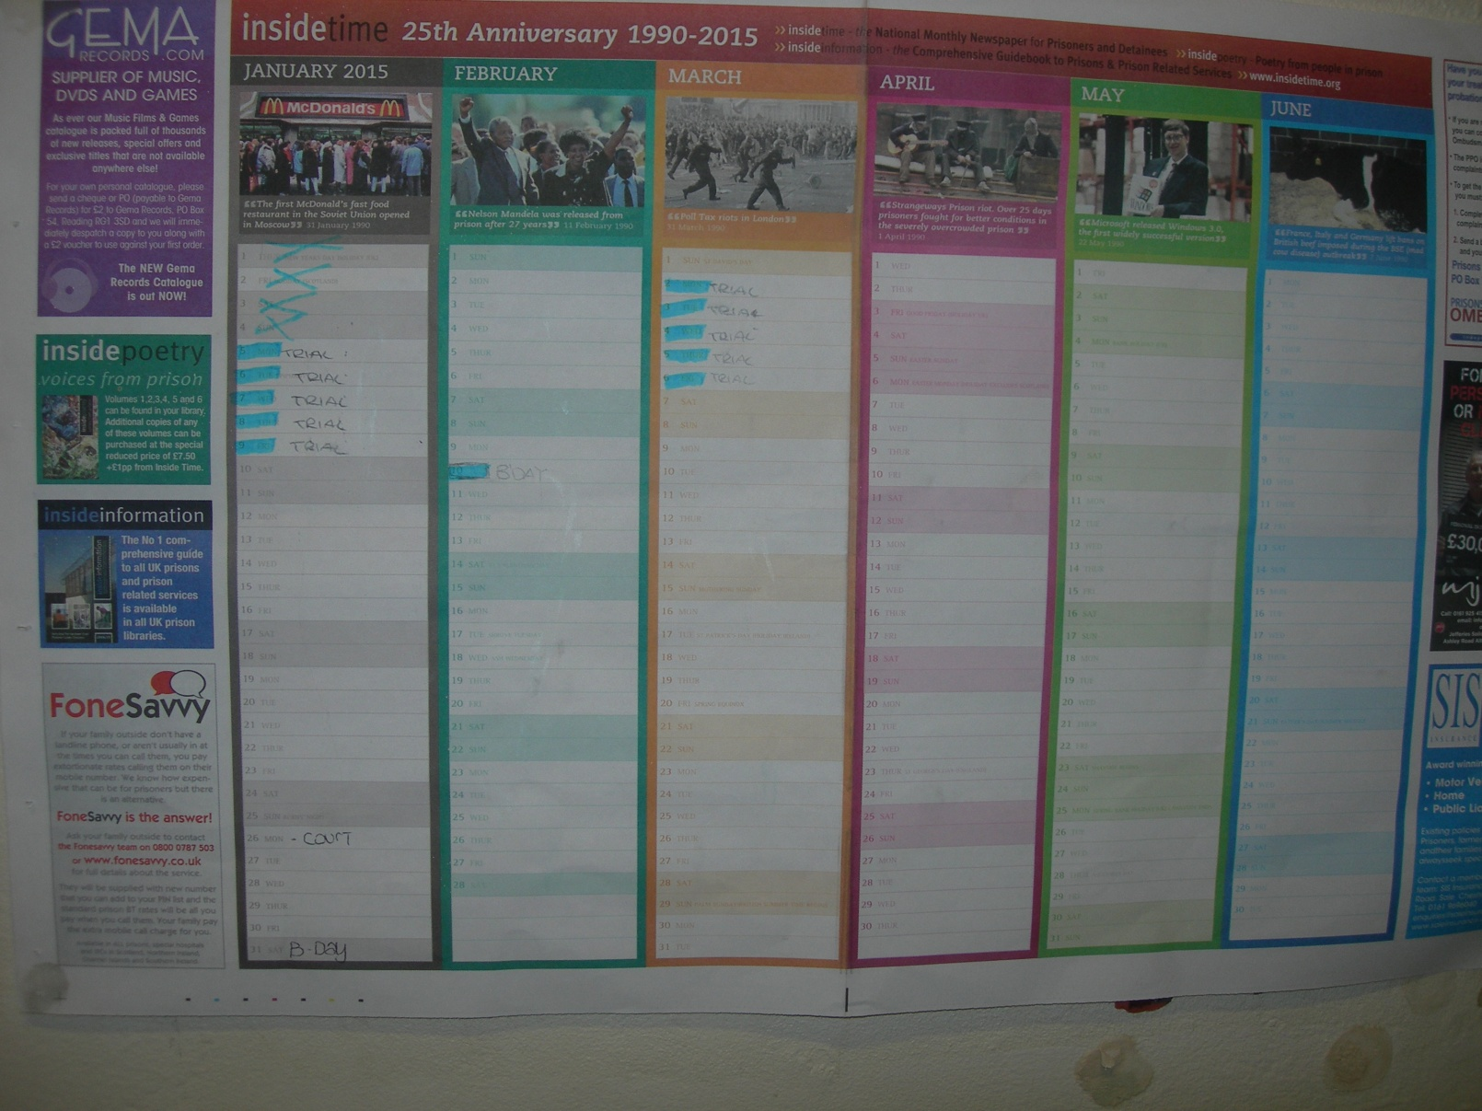
Notes:
HMP Pentonville – Prisoner calendar
Time out of cell:
Cat B _ More than 10 hours week days 6%; Less than 2 hours 31%
Cat C Trainers -More than 10 hours 17%; Less than 2 8%
Open Prison – More than 10 hours 61%; Less than 2 2%

Slide 27
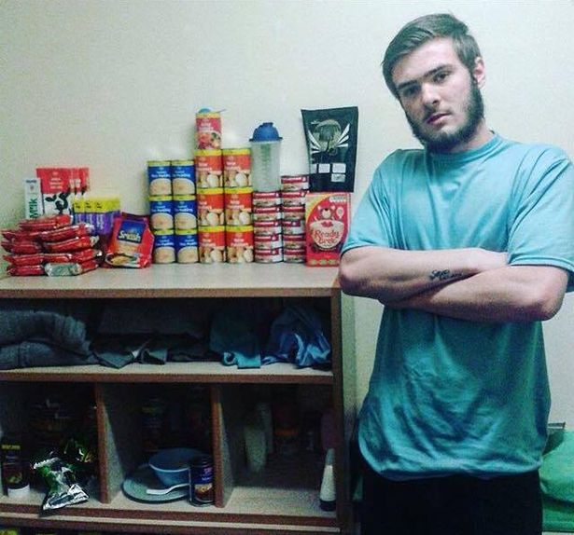

Slide 28
Things to do in your cell
(with thanks to Prison UK: An Insider’s View http://prisonuk.blogspot.co.uk)
“Sleep…Lie in bed…Lie on the bed…Get off the bed…Make the bed…Roll a cigarette…Smoke a cigarette…Get dressed…Eat breakfast (small packet of cereal with carton of milk)…Make a cup of tea (five prison tea-bags issued per day)…Wash up the bowl…Wash up the mug…Urinate…Defecate…Wash in the sink…Shave…Clean teeth…Clip nails (as required)…Clean the cell with a dustpan and brush…Read a book (assuming you have one)…Read a newspaper (assuming you order and pay for one)…Watch TV (assuming you’re not on Basic regime)…Listen to music (if you have a radio or CD player)…Write a letter (one free letter per week)…Read a letter (assuming you’ve received one)…Fill in menu sheet (once a week)…Fill in laundry list (once a week)…Fill in canteen sheet (once a week)…Write out a general app (application form…Sit and wait for a screw to open the cell door for showers (three times a week)…Sit and wait for a screw to open the cell door and use the wing payphone (twice a week)…Collect sandwich for lunch…Eat sandwich…Collect hot evening meal…Eat meal…Wash up plate and plastic utensils…Watch more TV…Look out of the cell window at the wall outside…Get undressed…Get into bed…Masturbate (optional – and easier in a single cell)…Try to sleep again despite the shouting and screaming around you… er, that’s about it, folks!”
To which I would add…
Be unbelievably bored…Fill in research and inspection surveys…Make a complaint…Prepare for court…Use you mobile…Study…Crafts…Contest the system…Communicate with neighbours…Brew hooch…Get off your head...Assault someone…Be assaulted…Self-harm…Have sex (in a double)…Worry…Reach boiling point…

Slide 29
Some questions to start with…
Why use prisoners as researchers?
How far can you extrapolate from individual experience to general conclusions?
Why should prisoners help you? What will they get of it?
Who are the ‘users’ of prisons? Prisoners? Staff? Victims? Public?

Slide 30
Some ethical issues - prisoners as researchers and research subjects
Dignity, safety and well being
Informed consent
Capacity
Diversity
Confidentiality and data protection
Reporting safety and security concerns
Pressures on prisoner researchers

Slide 31
Practical issues
Selection and training
Payment
Responsibility and accountability
Quality assurance
Risk assessment
Supervision
Professional and welfare support
IT!!!
Access
Data storage
Safeguarding
Protection from victimisation and storage after the research ends

Slide 32
Some solutions
Explanation of project to staff and prisoners
appropriate screening and selection processes for prisoner researchers
accredited training
an appropriately defined role and use of a job description
information provided to prisoners about available research roles
risk assessments taking into account both researchers and subjects
appropriate freedom of movement for prisoner researchers
supervision by staff and/or a research organisation
opportunities for prisoners researchers to share concerns and receive support.

Slide 33
Some suggestions for discussion
Roles for prisoner researchers
  Design
  Access
  Measuring
  Interviewing?
  Review
Prisoner researcher ethics code
  Informed consent
  Limitations on confidentiality
  Risks during and after the project
  Supervision

