Slide 1
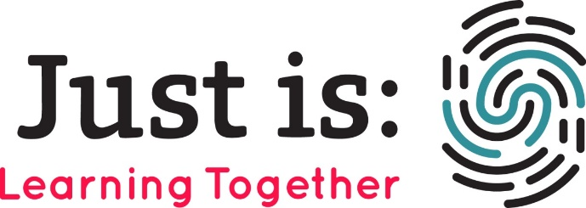
Learning Together: education across walls
Drs Ruth Armstrong and Amy Ludlow
University of Cambridge
justis@crim.cam.ac.uk
@JustisTogether

Slide 2
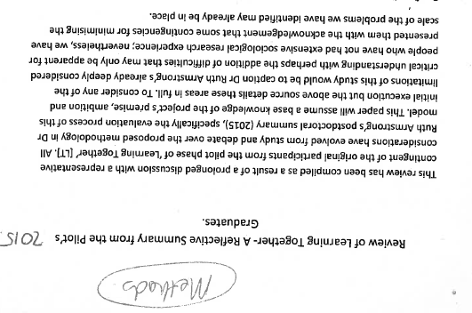
Journey towards participation
Intersections of criminological, educational and sociological theory.
Standard social science research methods: ethnographic observation, interviews, pre-post measures.

Slide 3
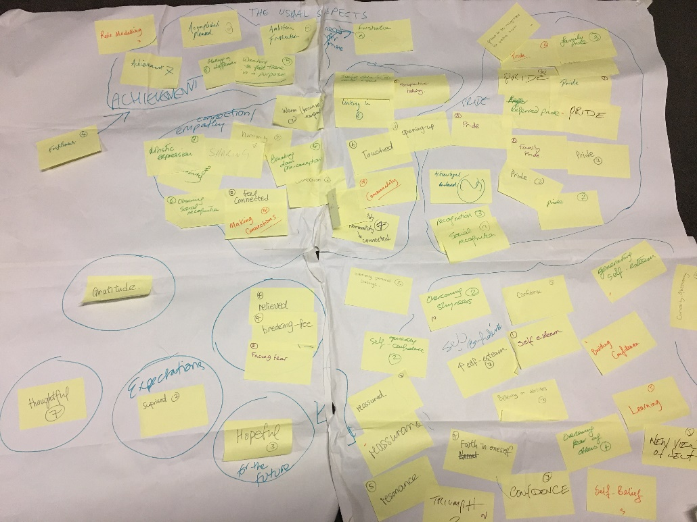

Slide 4

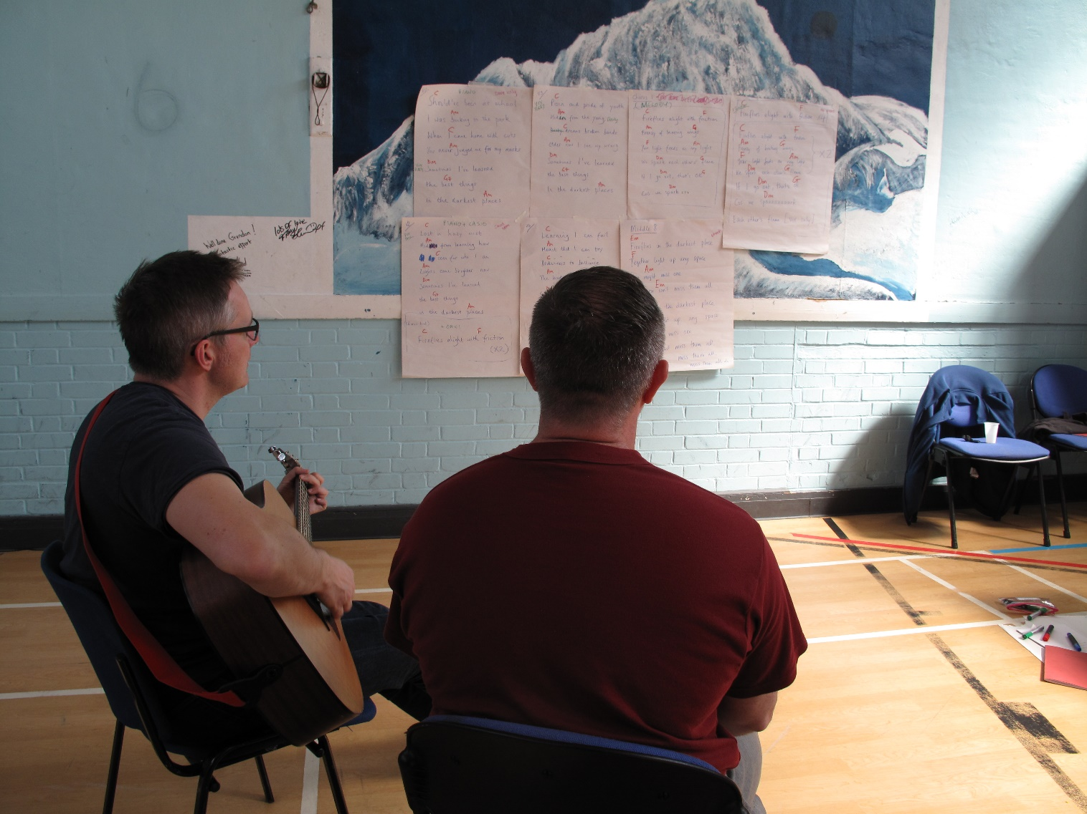
Mosaic Heart
Moses, Steve, Tom, Mark, Amisi, Amy and Ross
I only see in pieces yet recognize completely
In the tiles of this mosaic, truth held in fragility
I am blinded by perception, silhouette of my reflection
Misty futures hard to see, in my fragmented reality

Slide 5
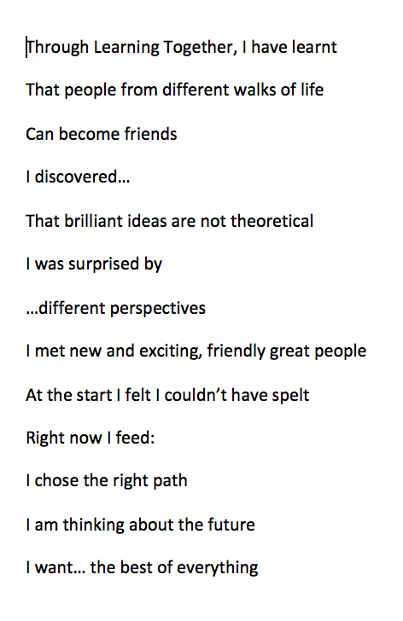
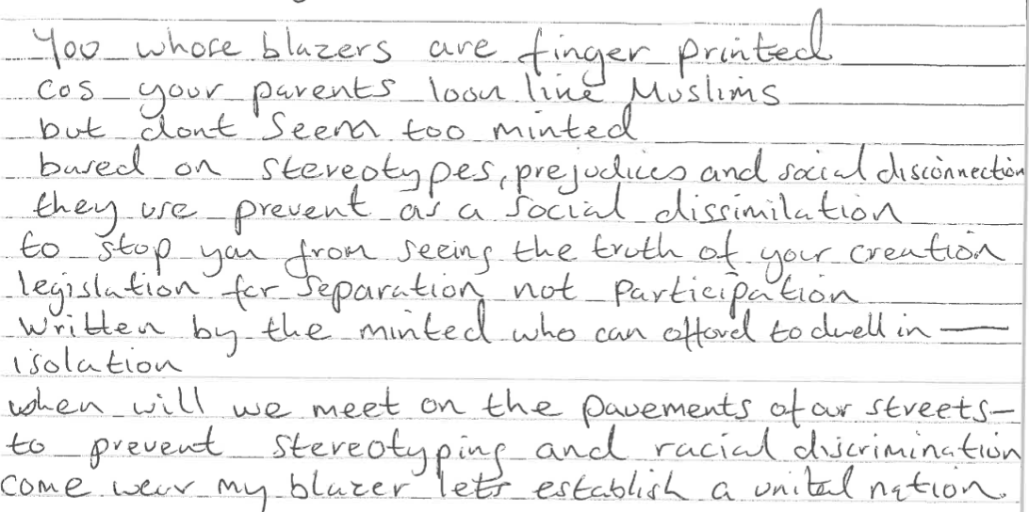
https://www.youtube.com/watch?v=GasEftVfyLI

Slide 6
Benefits
Prompted new questions – moved site of analysis and enquiry from individual to interpersonal and contextual, broadened theoretical perspective, increased critical reflection on theory-laden methodologies.
Moving further towards questions, than answers.
Greater consistency with underpinning theoretical framework for action.
Community building through transparency, humility and honesty in a ‘not knowingness’. Feeling part of something bigger that you can shape. A rebalancing of power that can empower students with diverse skills and experiences.
Participation as a gift not an extraction.
Learning new skills for us and our students.
A liberating chance to be me as a whole person researcher – and researched?
Repositioning of research funding as source of community investment.

Slide 7
But what about…
Sarah’s experience of story circles
Angela’s experience of story forms
Howard’s experience of song writing
Laura’s experience of performance poetry

Slide 8
Some questions from these experiences
Less objectifying?
Particular benefits for ‘vulnerable’ groups?
Potential for causing harm and pain – how to think about this and respond?
Challenges of replicability
Cost/time implications
Added complexity – questions, definitions of data, consent and confidentiality, positionality, ethics, endings and outputs
Are PAR / participatory distinctions helpful?

Slide 9
Discussion
What is good about (creative?) participation in research methods?
Is participation necessary to this good?
What are the risks/harms and how can these be minimalized/avoided?

